Slide 1
Image Resizing and Filtering
Interpolation

Slide 2
Image interpolation and resizing

Slide 3
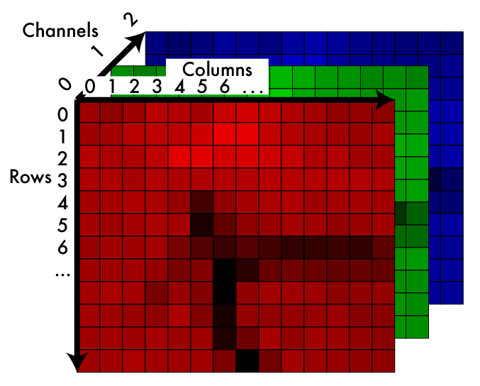
An image is like a function
An image is a mapping from indices to pixel value:
Im: I x I x I -> R
We may want to pass in
non-integers:
Im’: R x R x I -> R

Slide 4
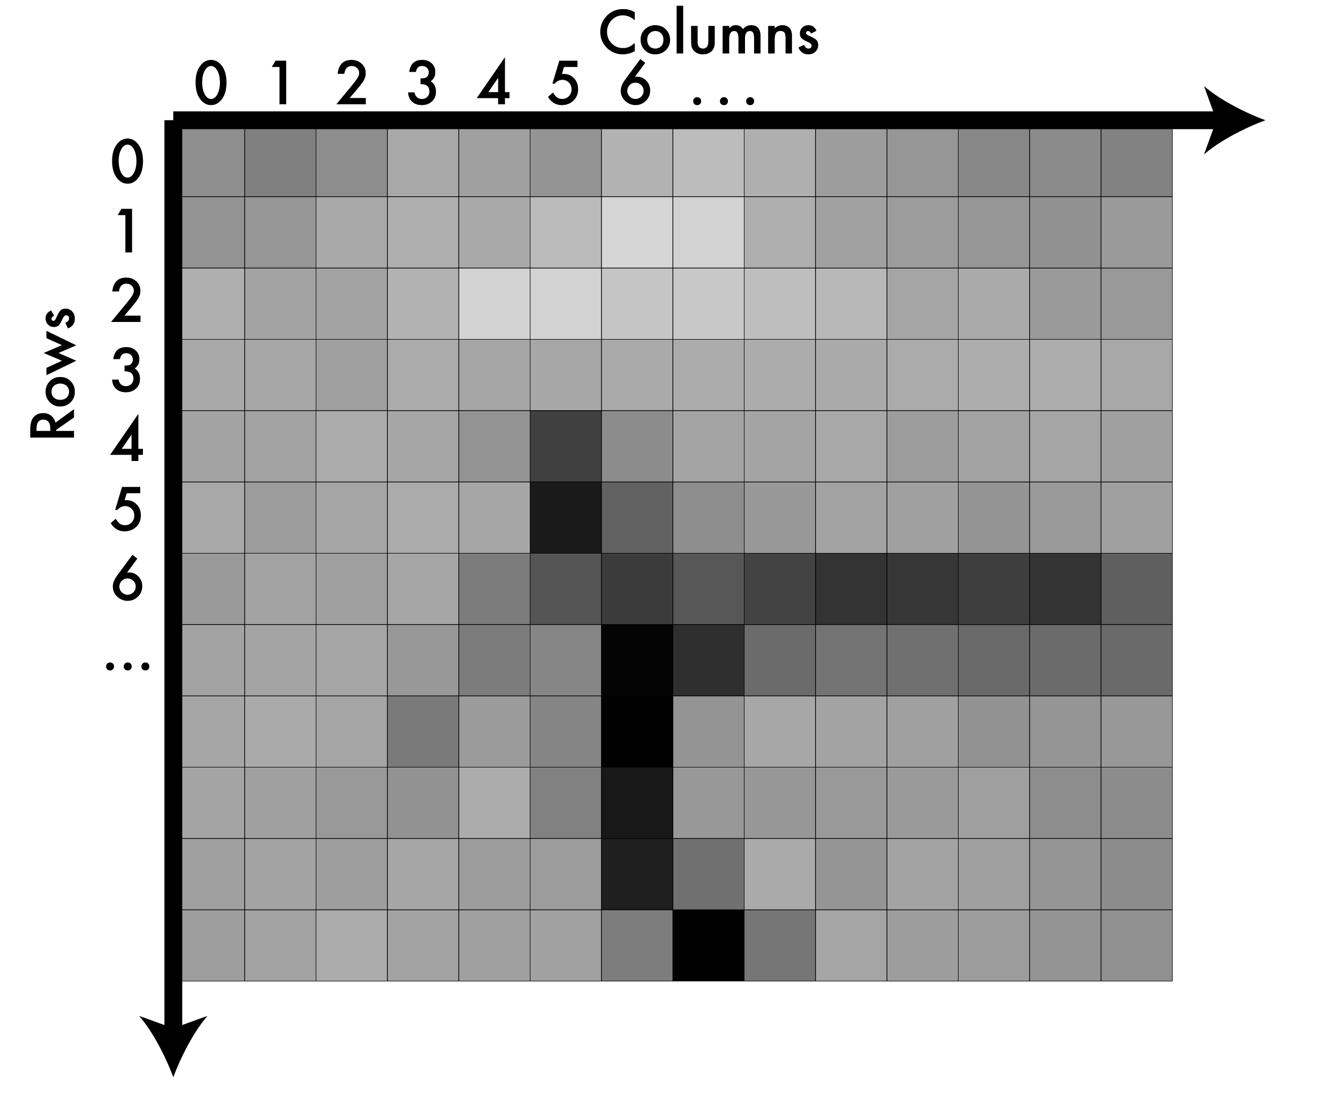
A note on coordinates in images
integer pixels

Slide 5
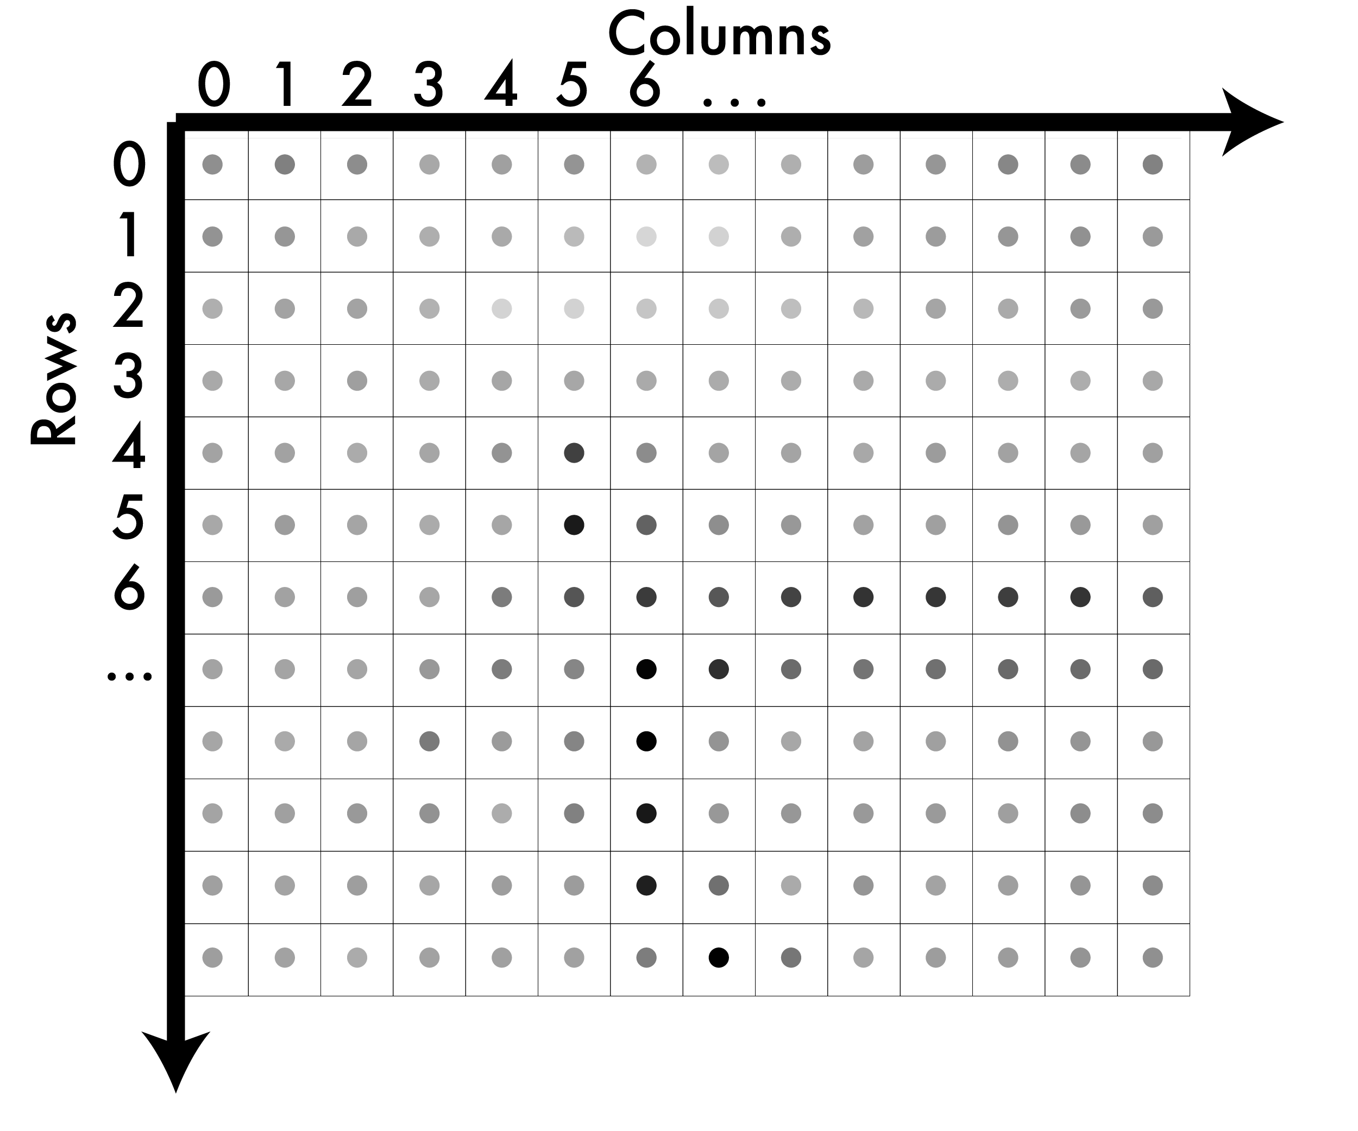
A note on coordinates in images
We can think of their
values as being at the
centers.

Slide 6
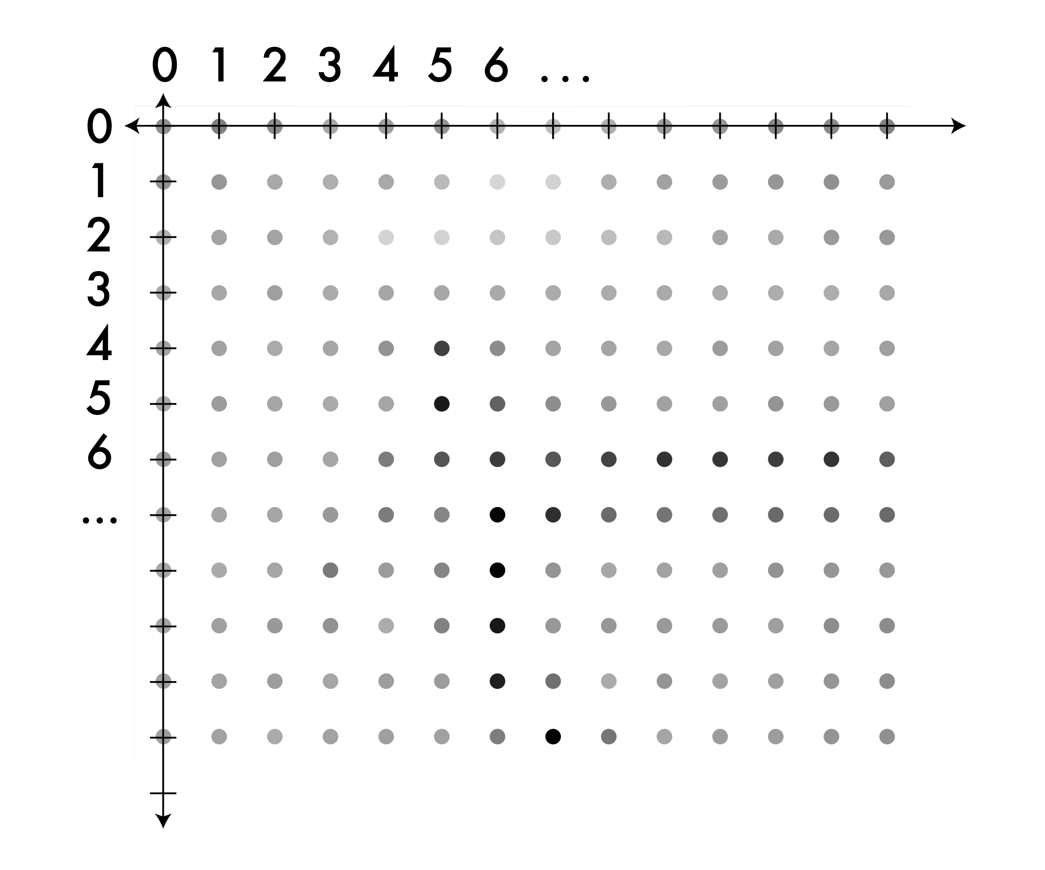
A note on coordinates in images
Now we can move to
a real coordinate
system.

Slide 7
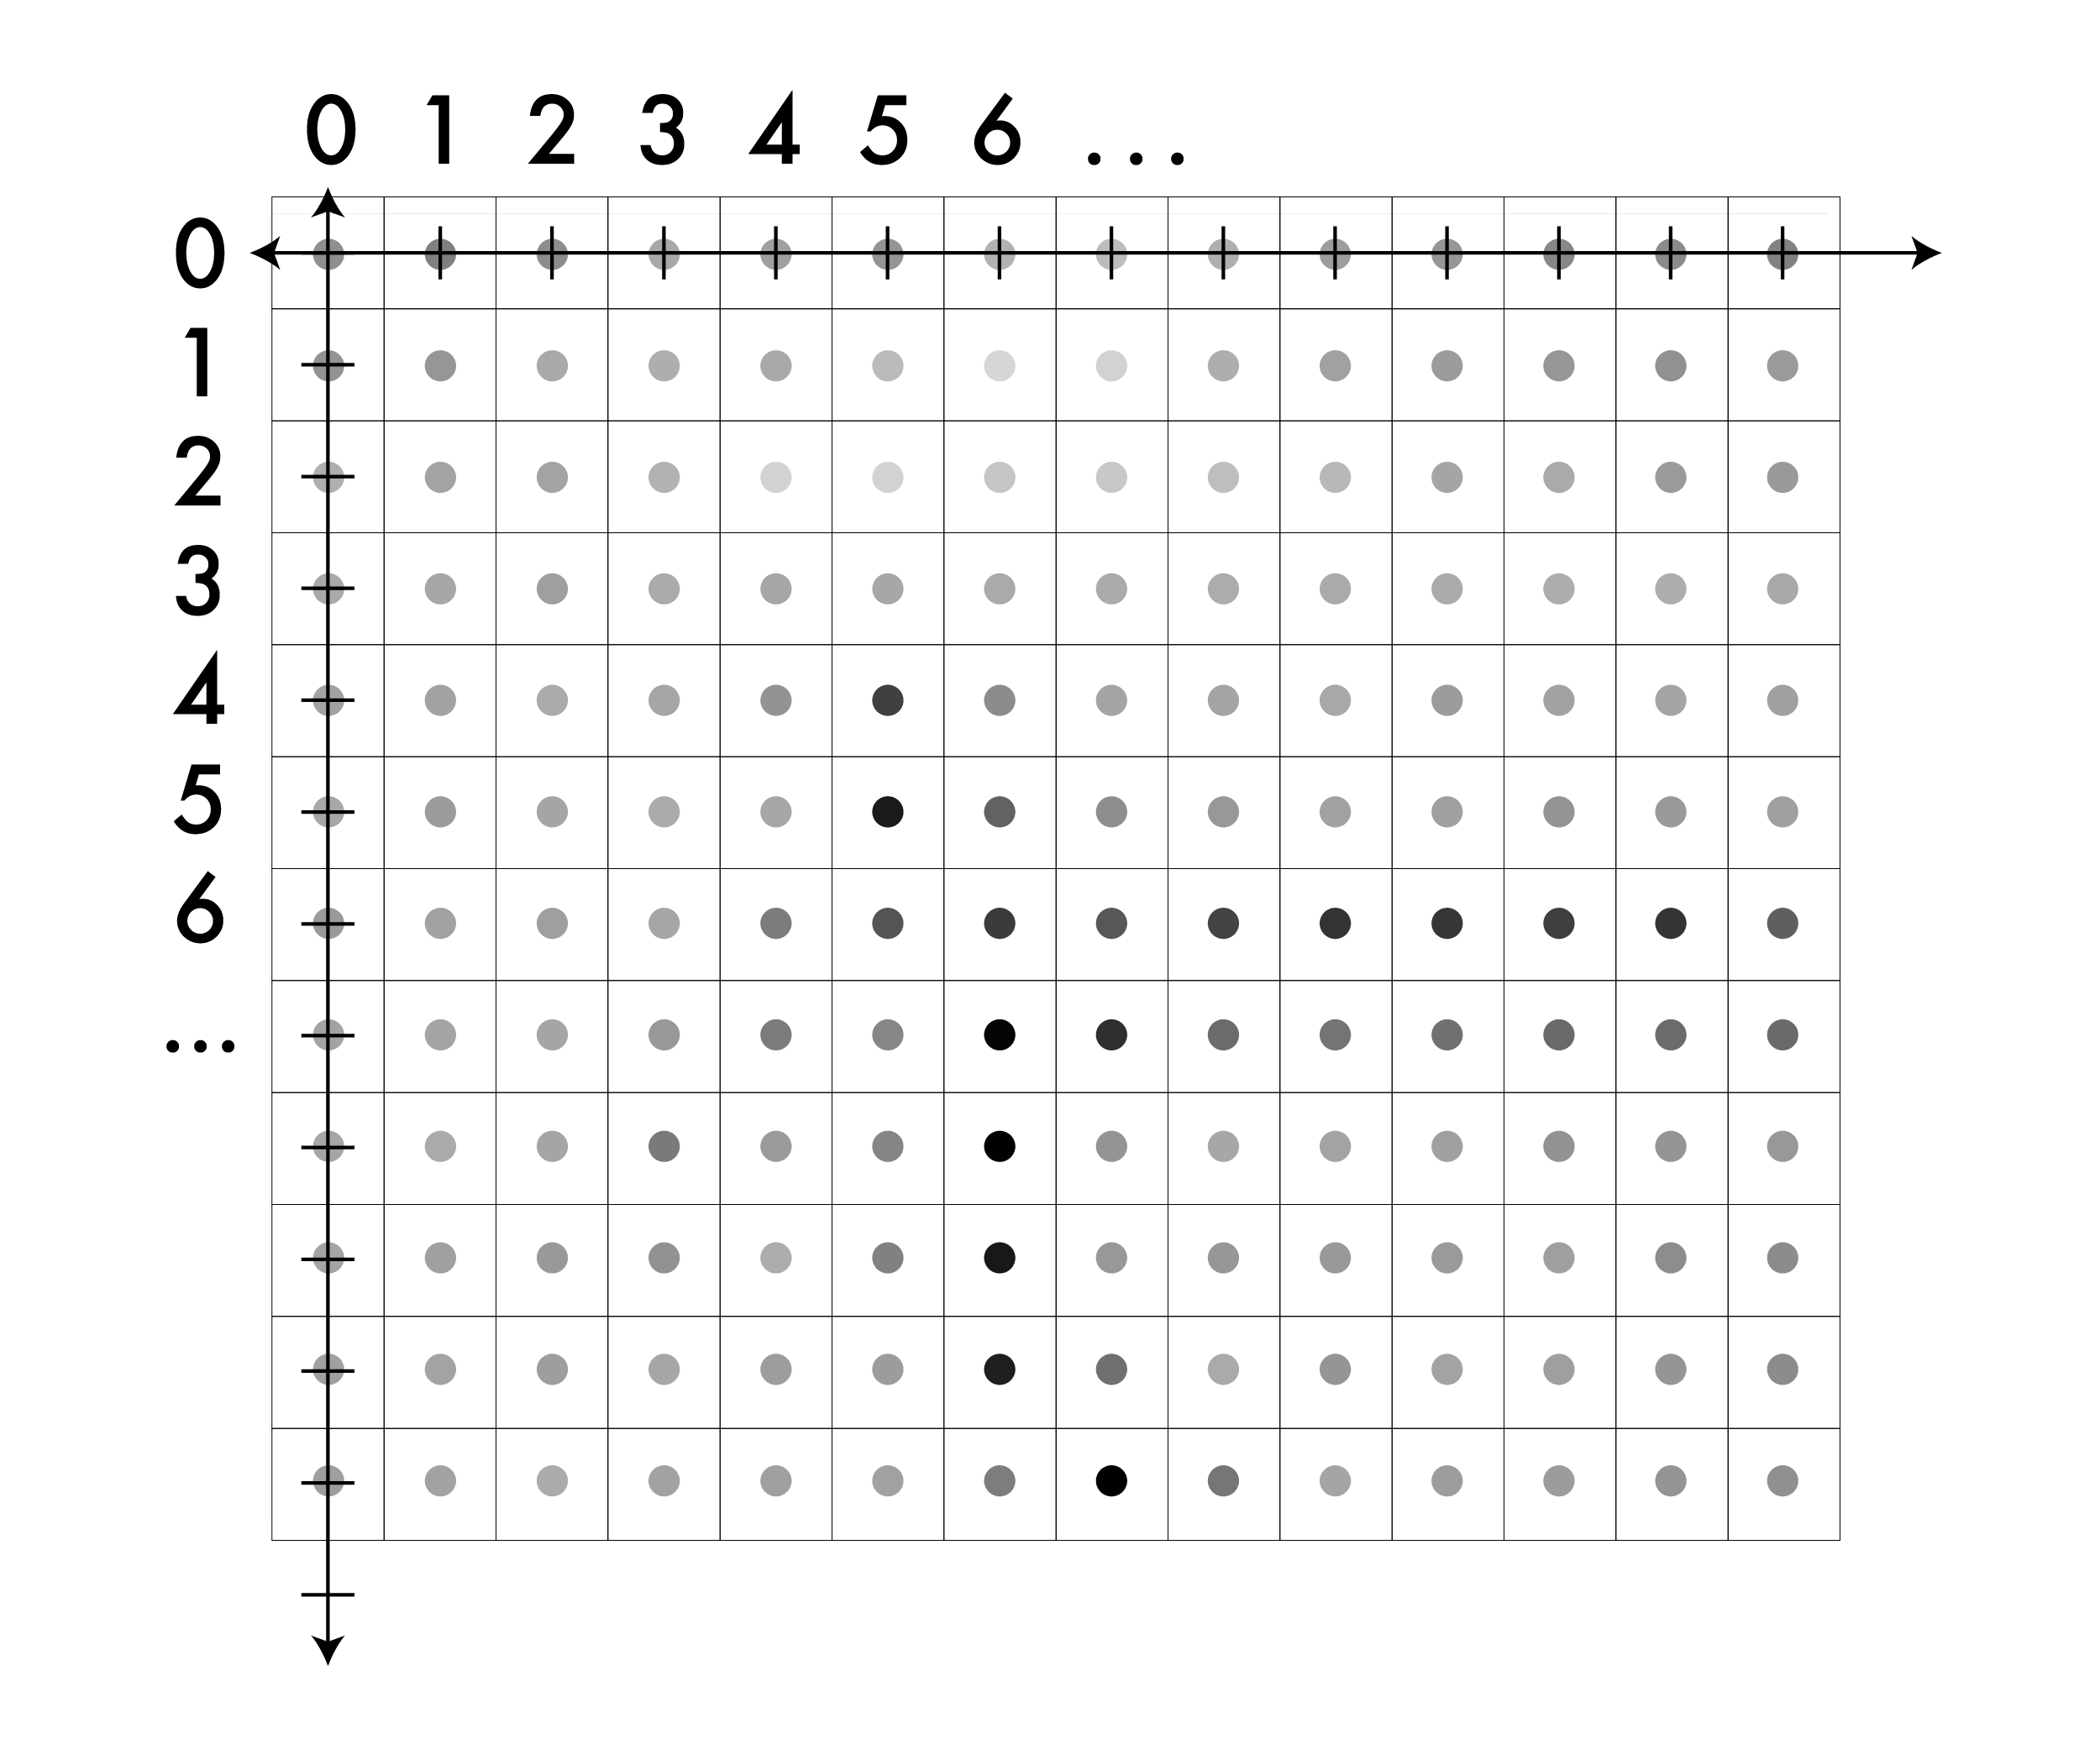
A note on coordinates in images
On the image

Slide 8
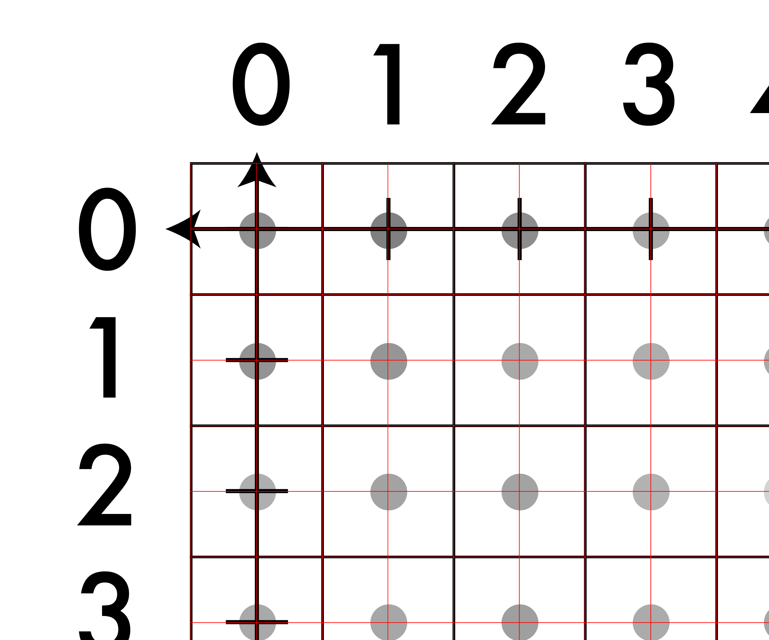
A note on coordinates in images
So, the value of the
pixel (x,y) is now
centered at (x,y).

Slide 9
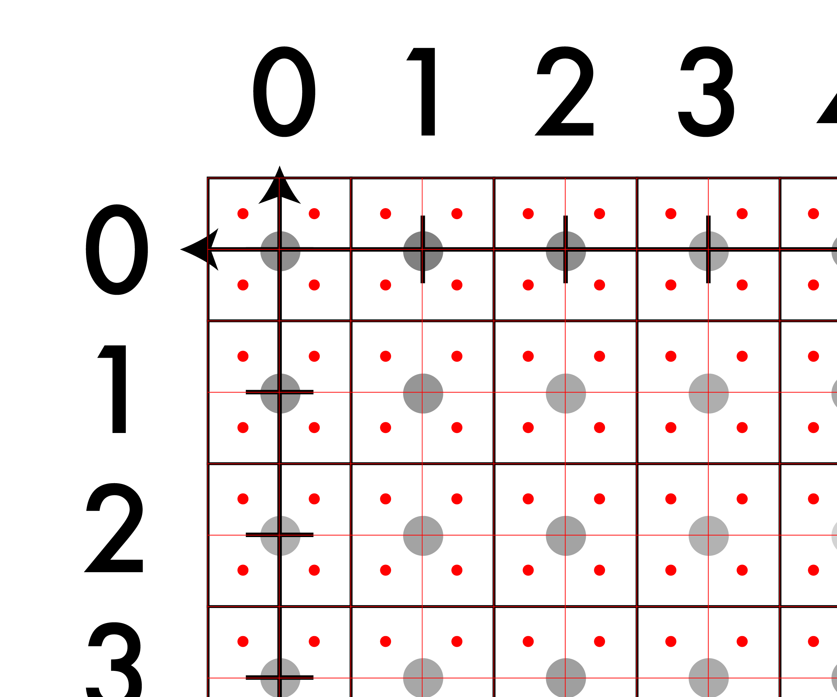
A note on coordinates in images
But there are other
real-valued points.

Slide 10
A note on coordinates in images
This point is:
(-.25, -.25)

Slide 11
Just be careful
This point is:
(-.25, -.25)

Slide 12
What is image interpolation?
An image f(x,y) tells us the intensity values at the integral lattice locations, i.e., when x and y are both integers
Image interpolation refers to the “guess” of intensity values at missing locations, i.e., x and y can be arbitrary
Note that it is just a guess

Slide 13
Interpolation
How do we find out the VALUE of a non-integer point, when the image only comes with integer points, ie (25,45,3).
For assignment:
1. Nearest-Neighbor Interpolation
2. Bilinear Interpolation

Slide 14

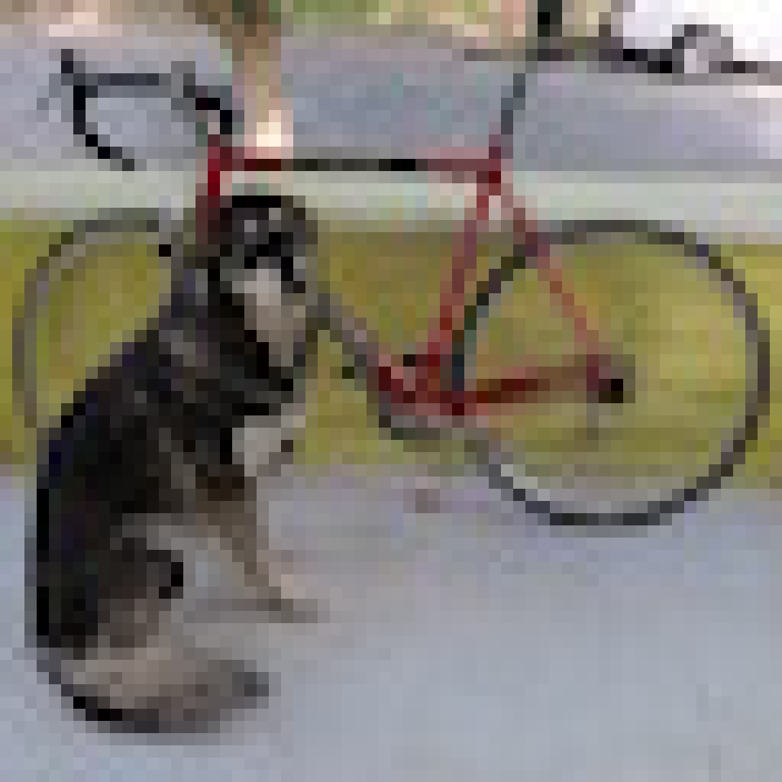
Nearest neighbor: what it sounds like
f(x,y,z) = Im(round(x), round(y), z)
Looks blocky
Common pitfall: Integer division rounds down in C
Note: z is still int

Slide 15

Resize algorithm:
For each pixel in new image:
1. Map to old im coordinates
2. Interpolate value
3. Set new value in image

Slide 16
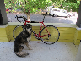
What about shrinking?
NN and Bilinear only look at small area
Lots of artifacting
Staircase pattern on diagonal lines

Slide 17
So what is this interpolation useful for?

Slide 18

Image resizing!
Say we want to increase the size of an image…
This is a beautiful image of a sunset… it’s just very small…

Slide 19
Linear Interpolation:
Linear Interpolation means estimating values using linear polynomials.
Example:
Suppose we have two points P1(20) and P4(30) and we want to estimate the between these two points.

Slide 20
20
30
P1 (0)
P2 (1)
P3 (2)
P4 (3)
P2 = 2/3 * P1 + 1/3 * P4
= 2/3 * 20 + 1/3 * 30
= 23.33
P4 = 1/3 * P1 + 2/3 * P4
= 1/3 * 20 + 2/3 * 30
= 26.67

Slide 21
20
23.33
26.67
30
P1 (0)
P2 (1)
P3 (2)
P4 (3)
P2 = 2/3 * P1 + 1/3 * P4
= 2/3 * 20 + 1/3 * 30
= 23.33
P4 = 1/3 * P1 + 2/3 * P4
= 1/3 * 20 + 2/3 * 30
= 26.67

Slide 22
Linear Interpolation
Linear Interpolation (y) = y1+(x−x1)(y2−y1)
(x2−x1)
Find P2=y=?
Where x= 1,
x2=3,
x1=0
y2=30
y1=20
Now, You can find y=?

Slide 23
Linear Interpolation
Linear Interpolation(y) = y1+(x−x1)(y2−y1)
(x2−x1)
Similarly Find P3=y=?
Where x= 2,
x2=3,
x1=0
y2=30
y1=20
Now, You can find y=?

Slide 24
More Examples
f(n)=[0,120,180,120,0]
Interpolate at 1/2-pixel f(x)=[0,60,120,150,180,150,120,60,0], x=n/2
Interpolate at 1/3-pixel f(x)=[0,20,40,60,80,100,120,130,140,150,160,170,180,…], x=n/6

Slide 25
Bi-Linear Interpolation

Slide 26
Let’s do something interesting already!!

Slide 27
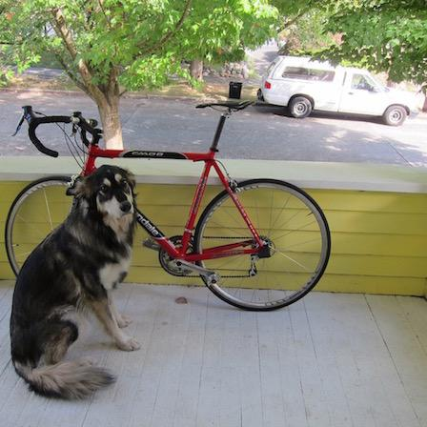
Want to make image smaller

Slide 28
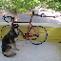
448x448 -> 64x64

Slide 29

448x448 -> 64x64

Slide 30
448x448 -> 64x64

Slide 31

448x448 -> 64x64

Slide 32
448x448 -> 64x64

Slide 33
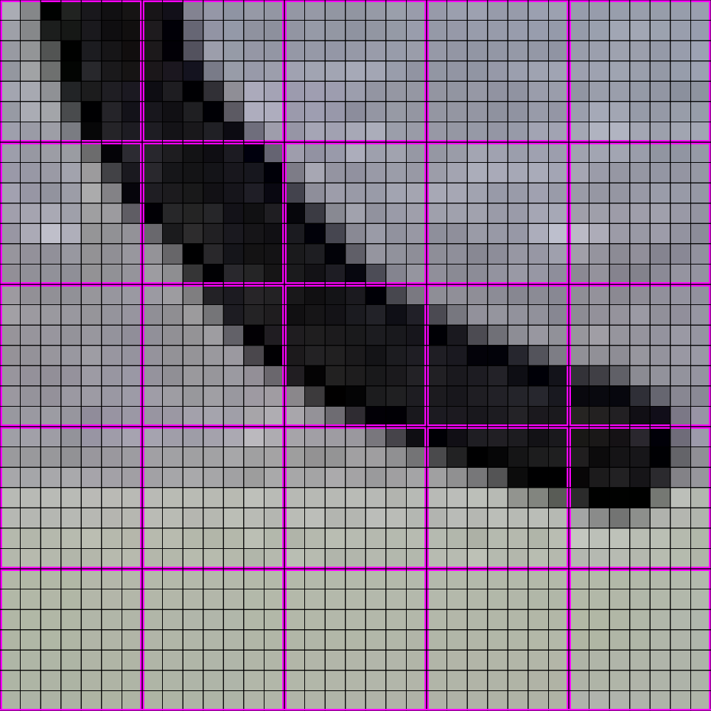
448x448 -> 64x64
Note: this example assumes that the
interpolation lands at the center of
each of the big 7 x 7 areas of pixels.

Slide 34

448x448 -> 64x64

Slide 35
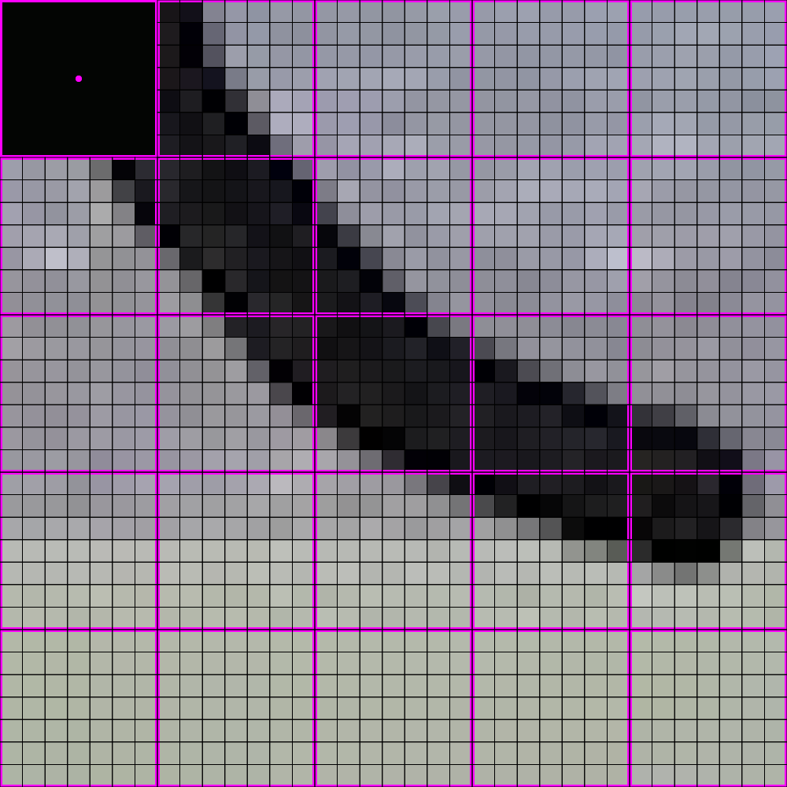
448x448 -> 64x64

Slide 36

448x448 -> 64x64

Slide 37
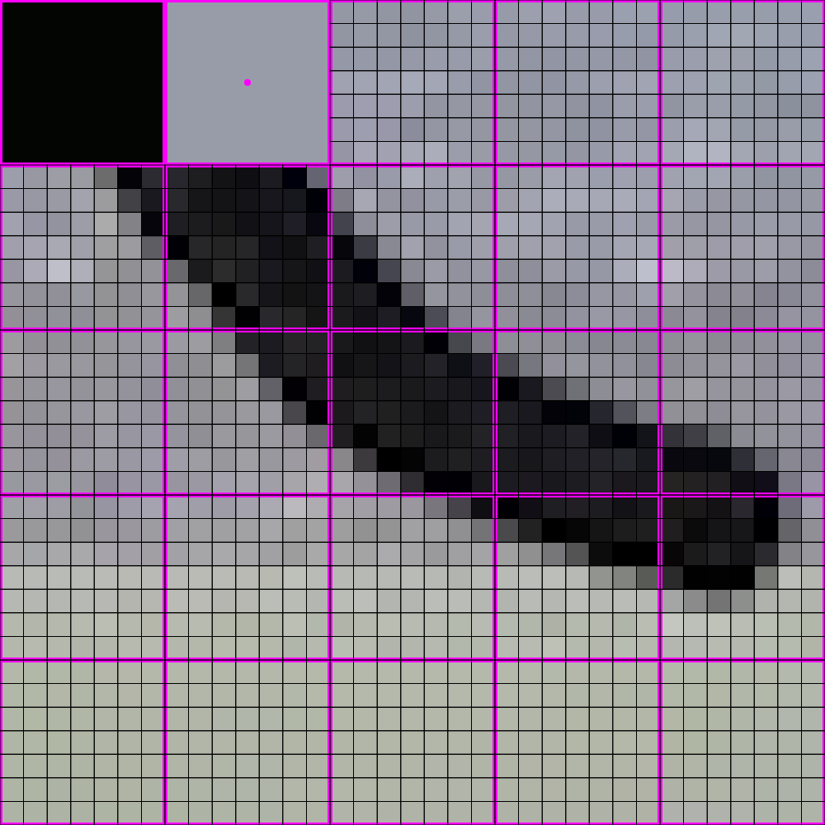
448x448 -> 64x64

Slide 38

448x448 -> 64x64

Slide 39
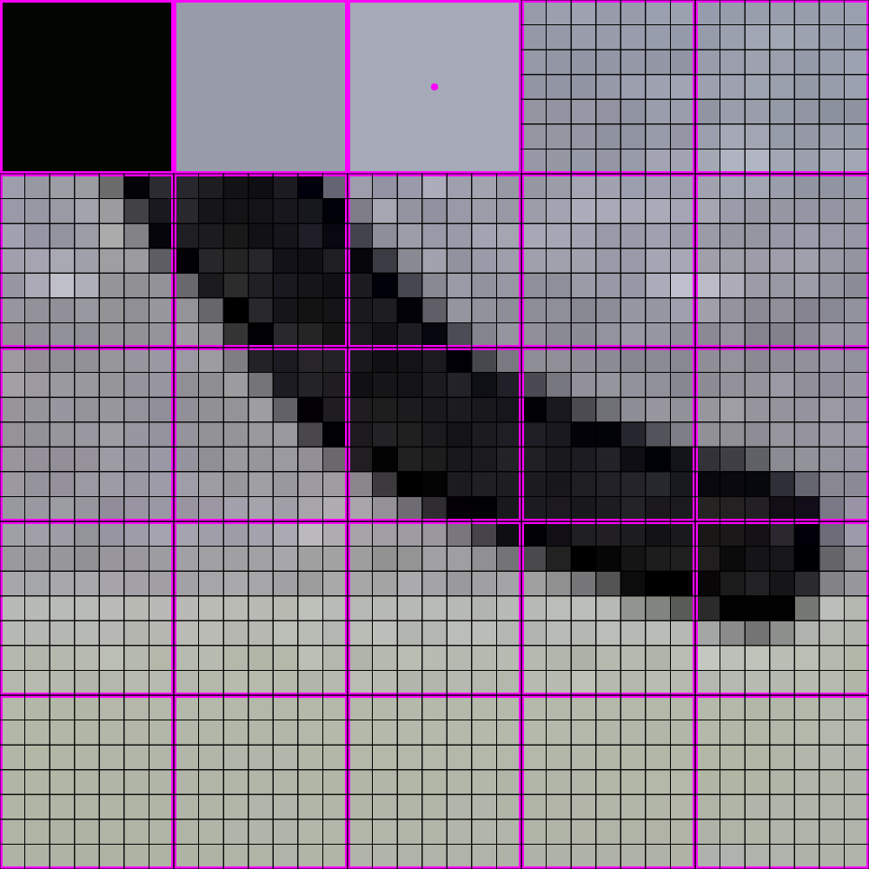
448x448 -> 64x64

Slide 40

448x448 -> 64x64

Slide 41
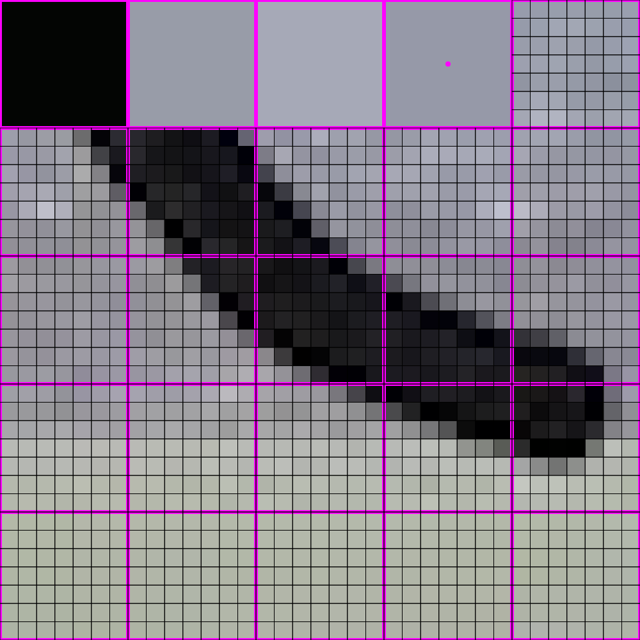
448x448 -> 64x64

Slide 42

448x448 -> 64x64

Slide 43
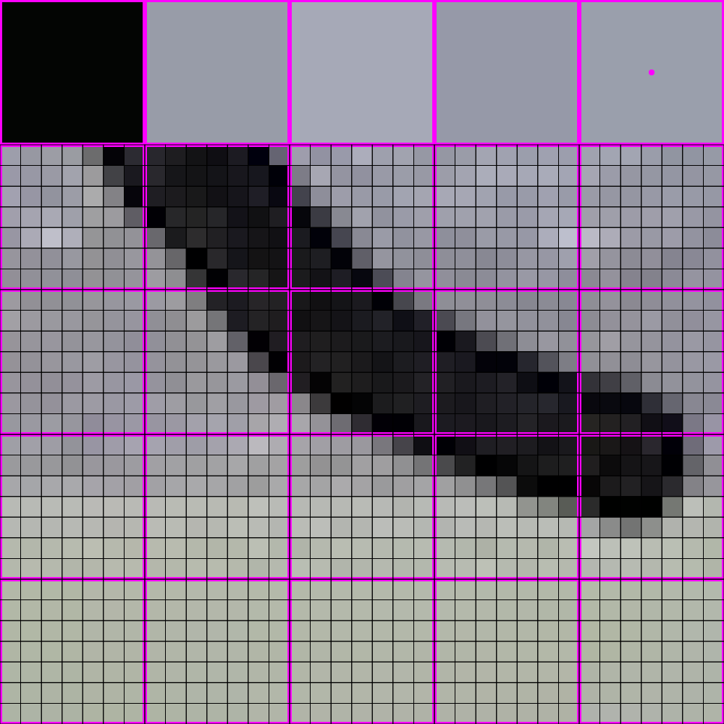
448x448 -> 64x64

Slide 44

448x448 -> 64x64

Slide 45
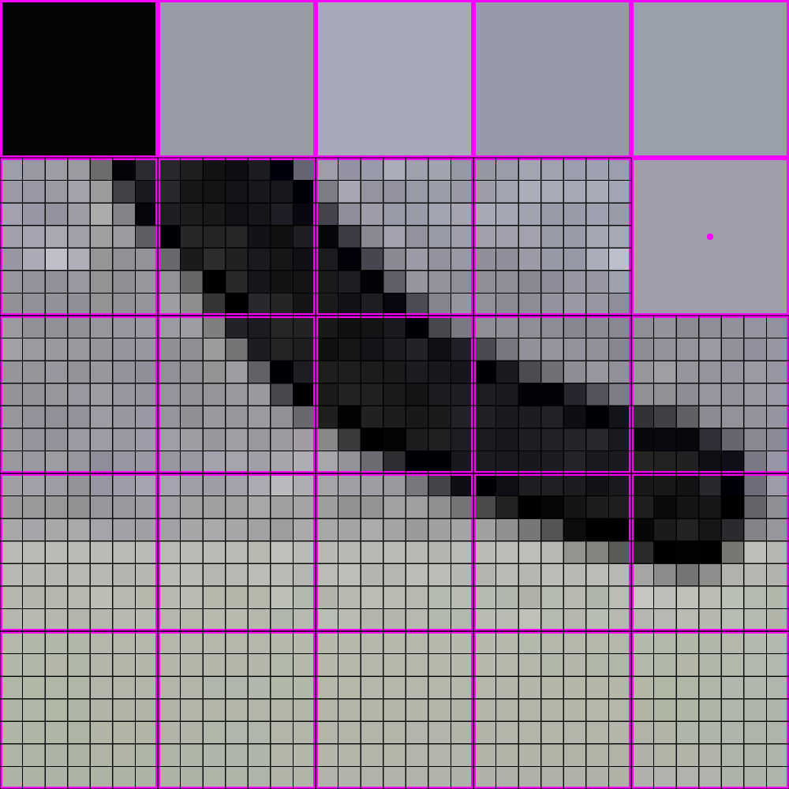
448x448 -> 64x64

Slide 46
448x448 -> 64x64

Slide 47

448x448 -> 64x64

Slide 48
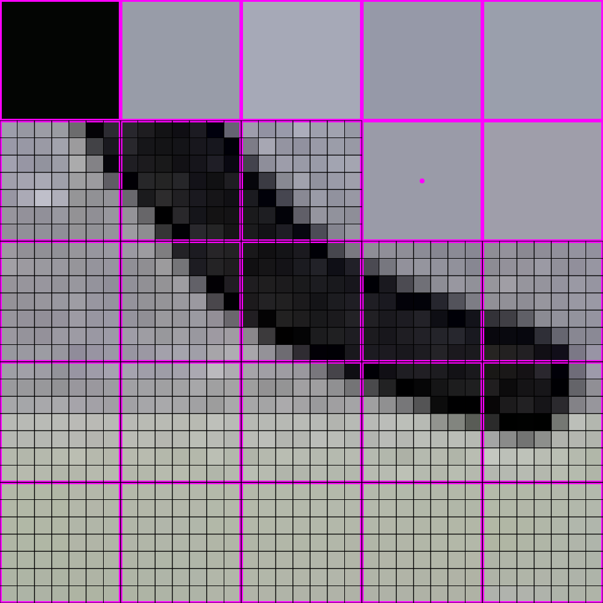
448x448 -> 64x64

Slide 49

448x448 -> 64x64

Slide 50
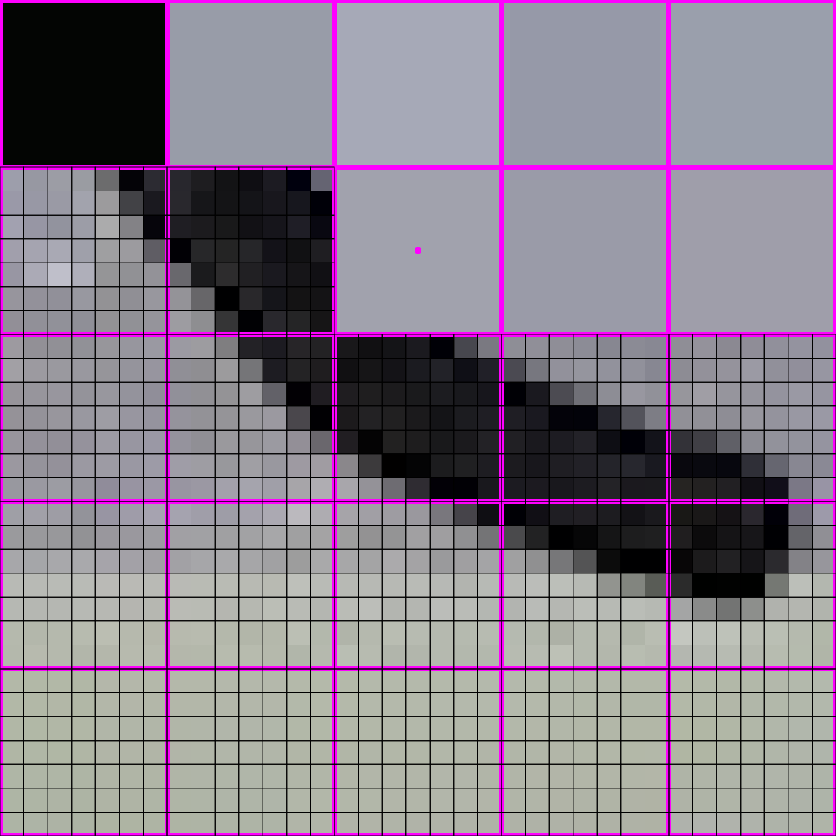
448x448 -> 64x64

Slide 51
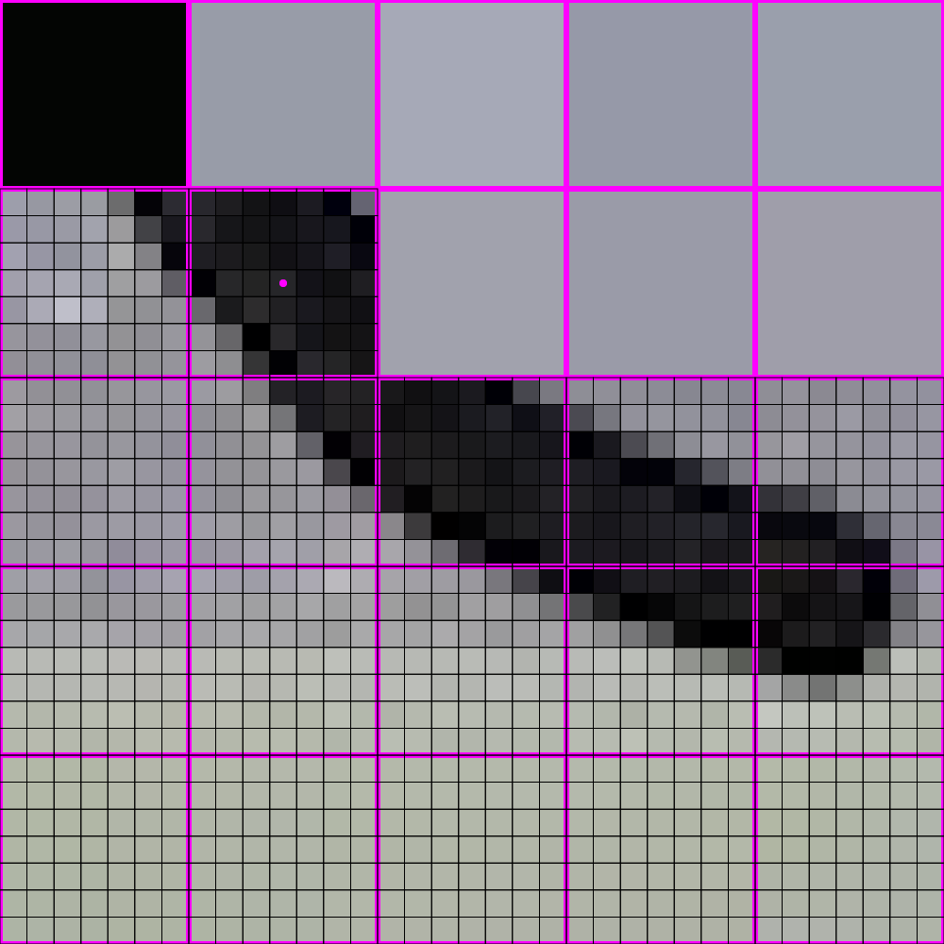
448x448 -> 64x64

Slide 52
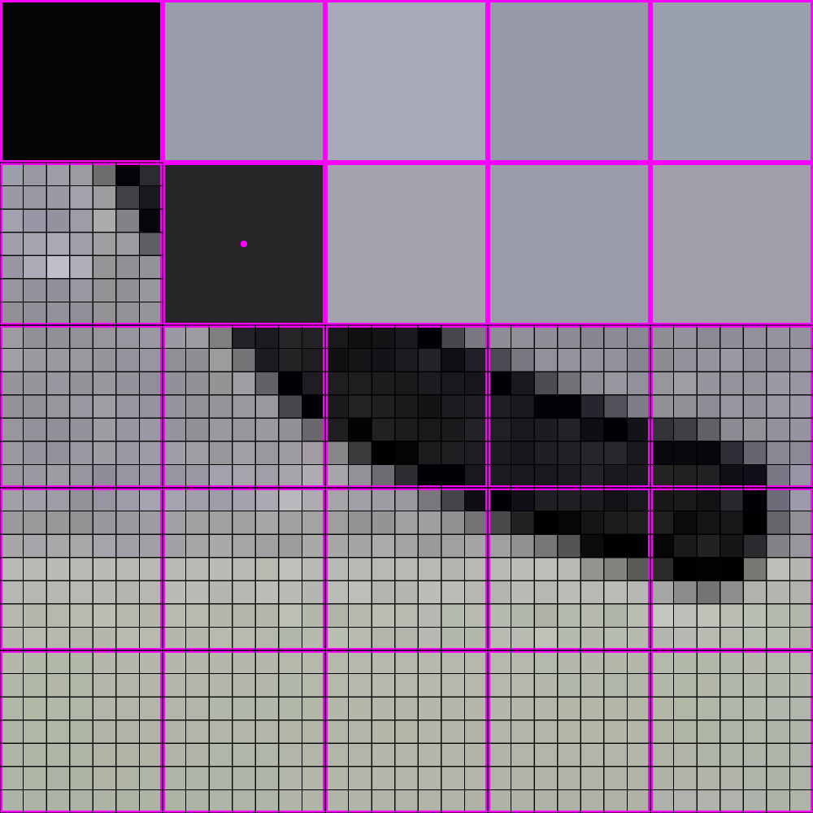
448x448 -> 64x64

Slide 53
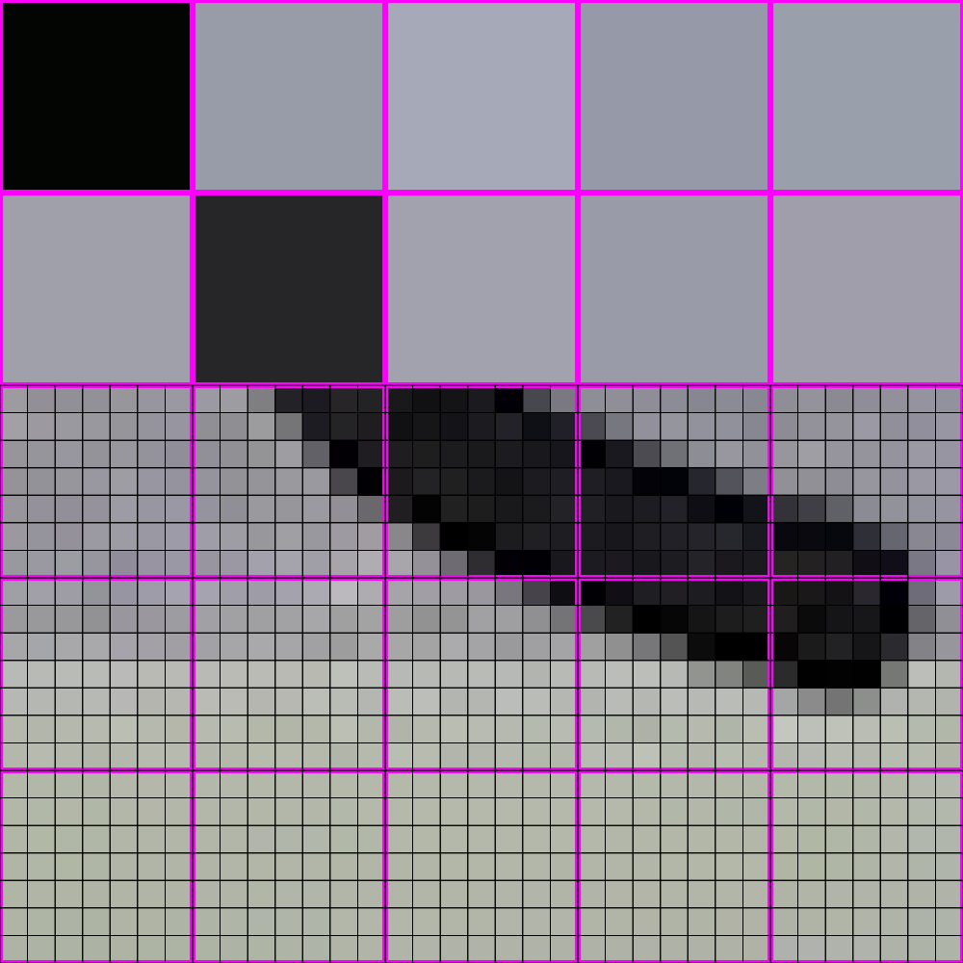
448x448 -> 64x64

Slide 54
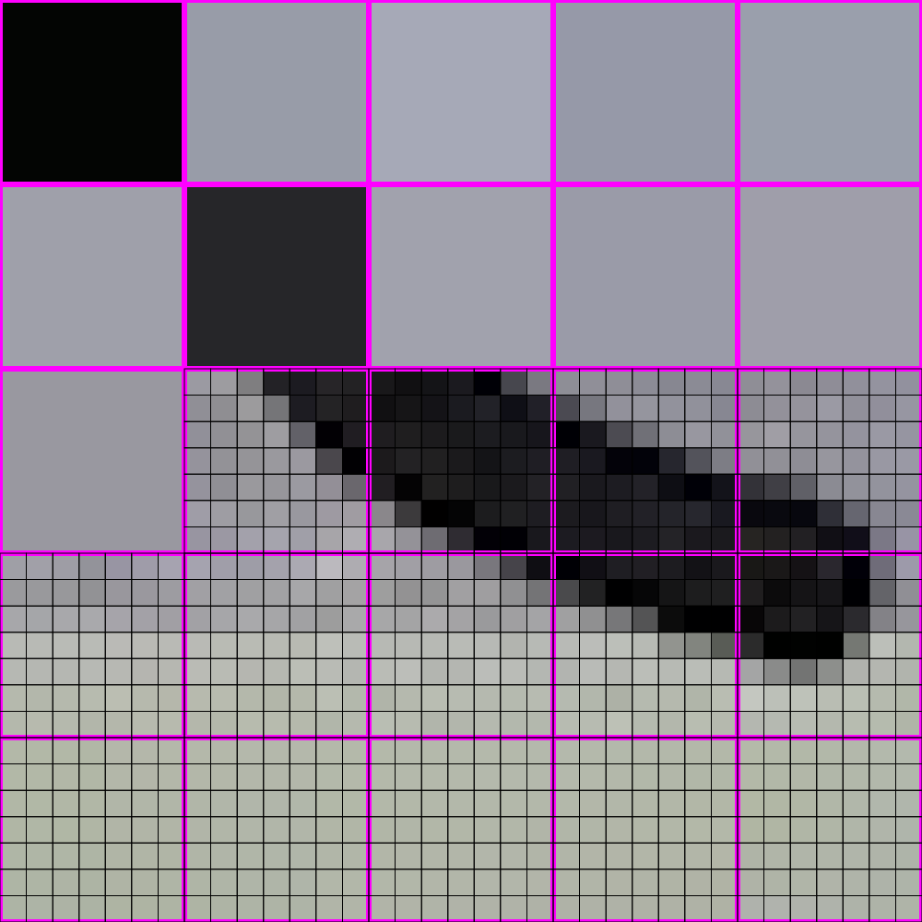
448x448 -> 64x64

Slide 55
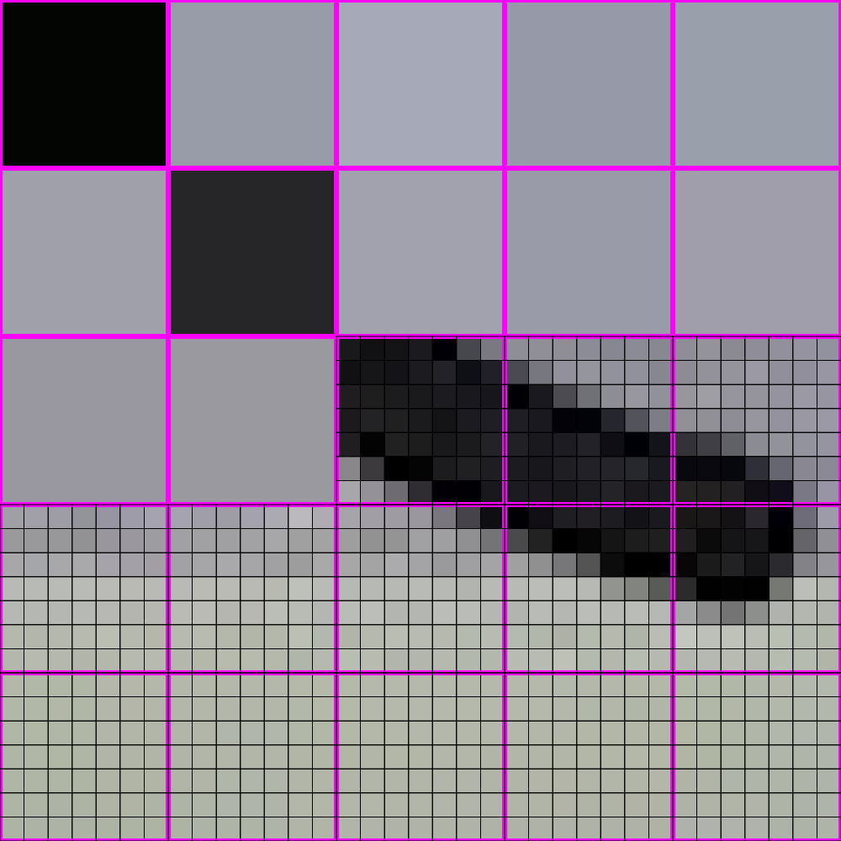
448x448 -> 64x64

Slide 56
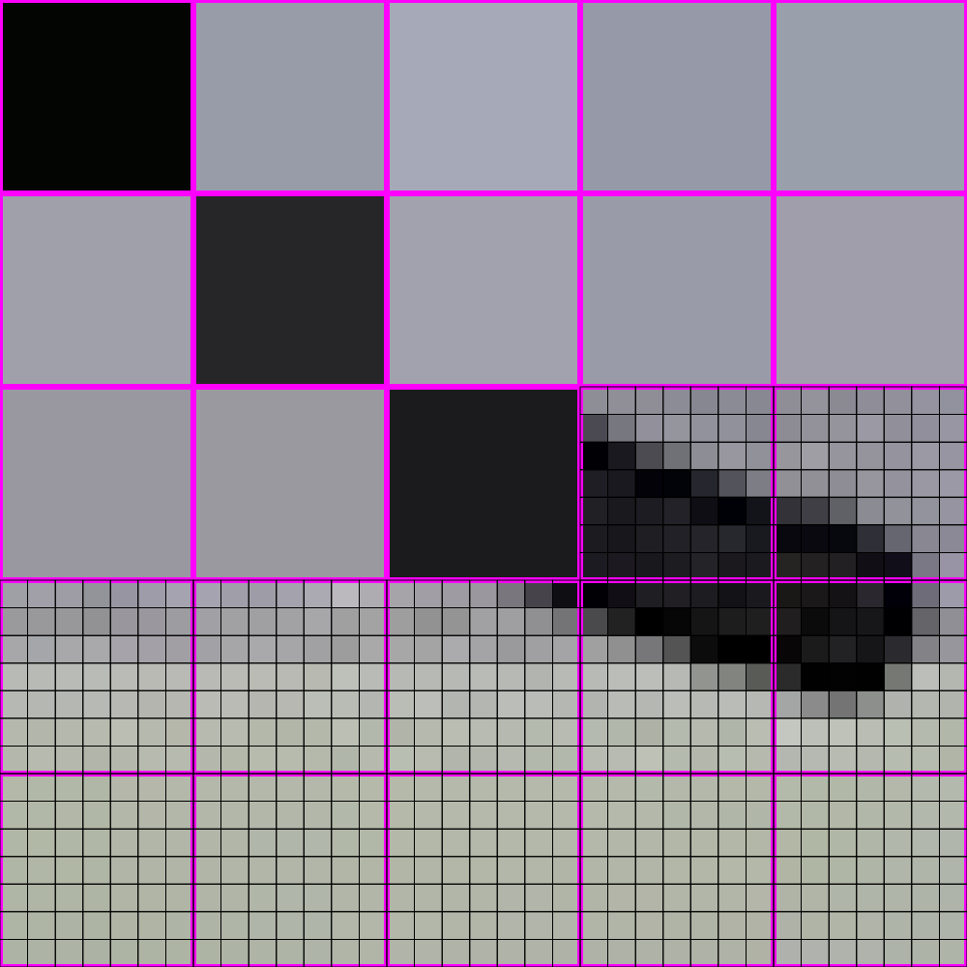
448x448 -> 64x64

Slide 57
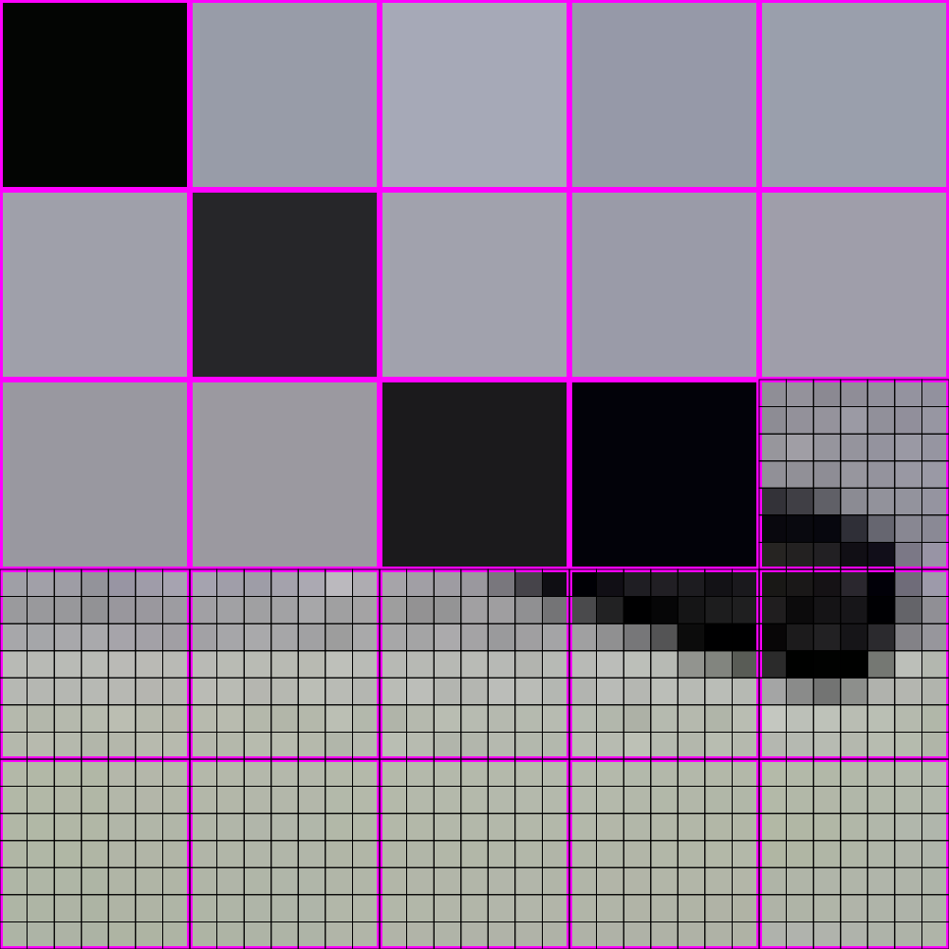
448x448 -> 64x64

Slide 58
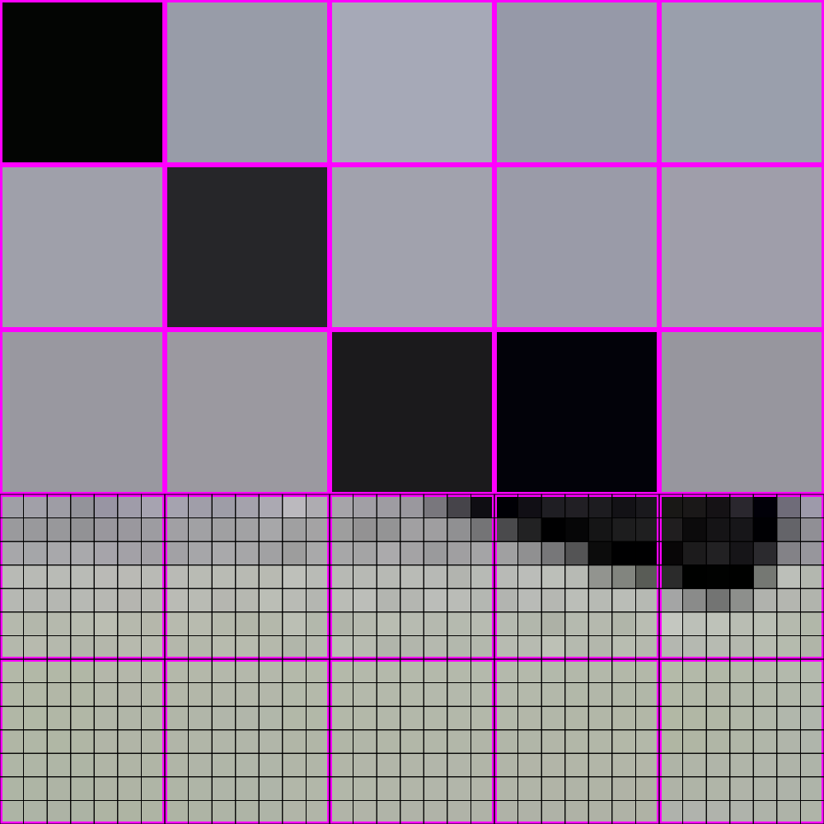
448x448 -> 64x64

Slide 59
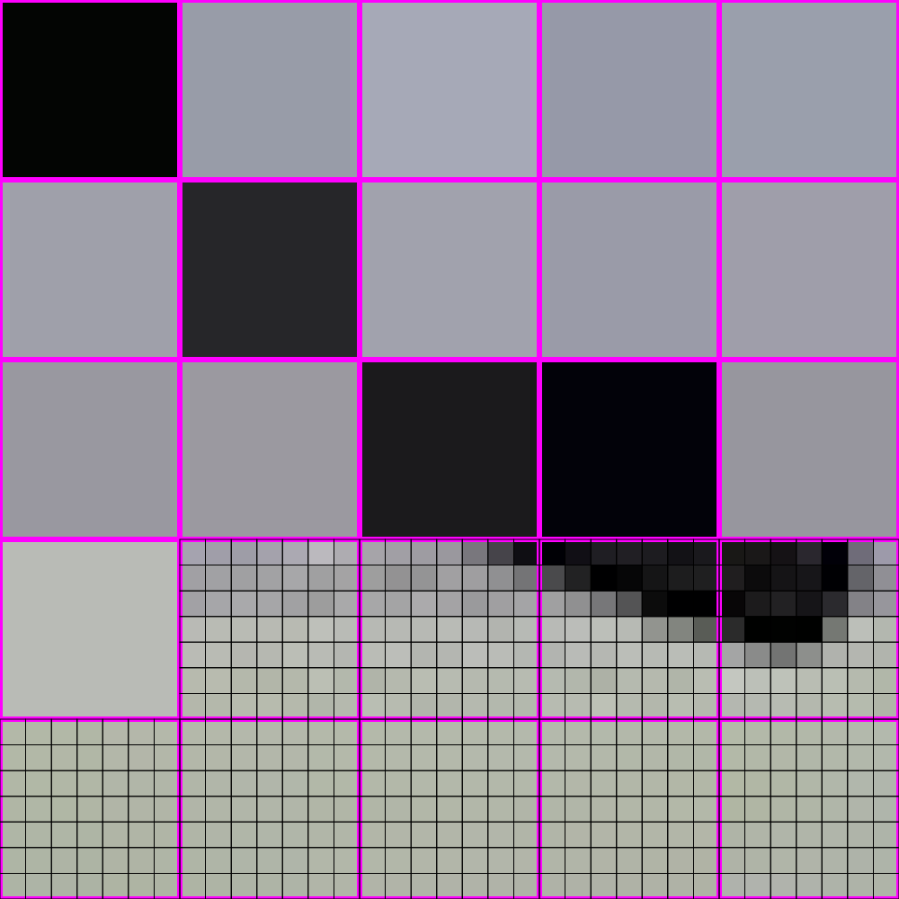
448x448 -> 64x64

Slide 60
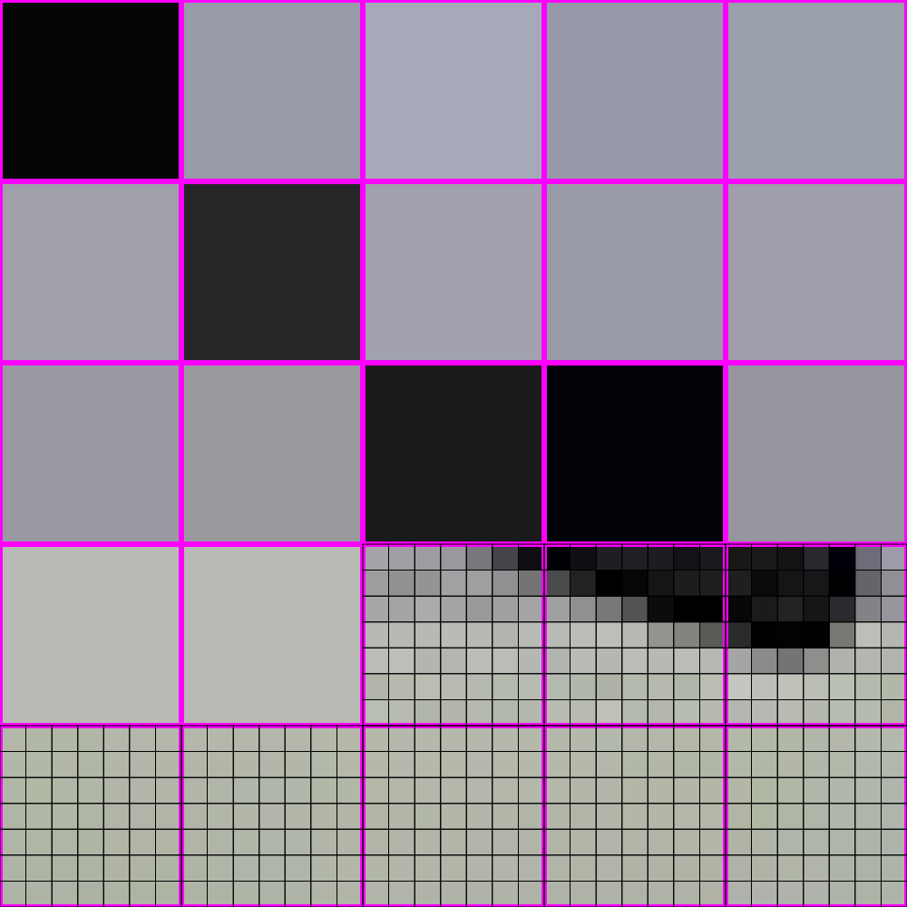
448x448 -> 64x64

Slide 61
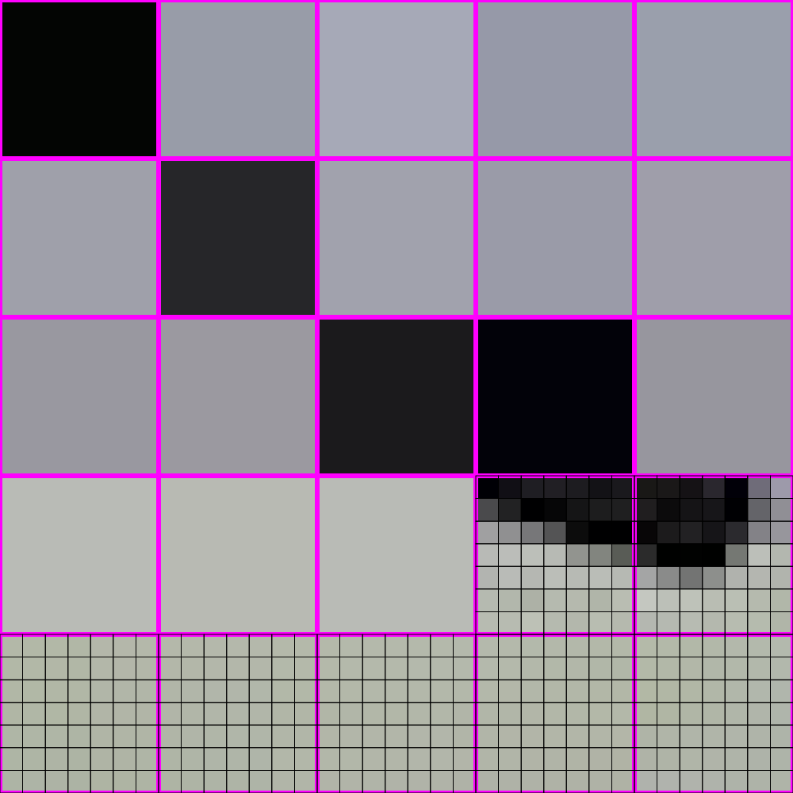
448x448 -> 64x64

Slide 62
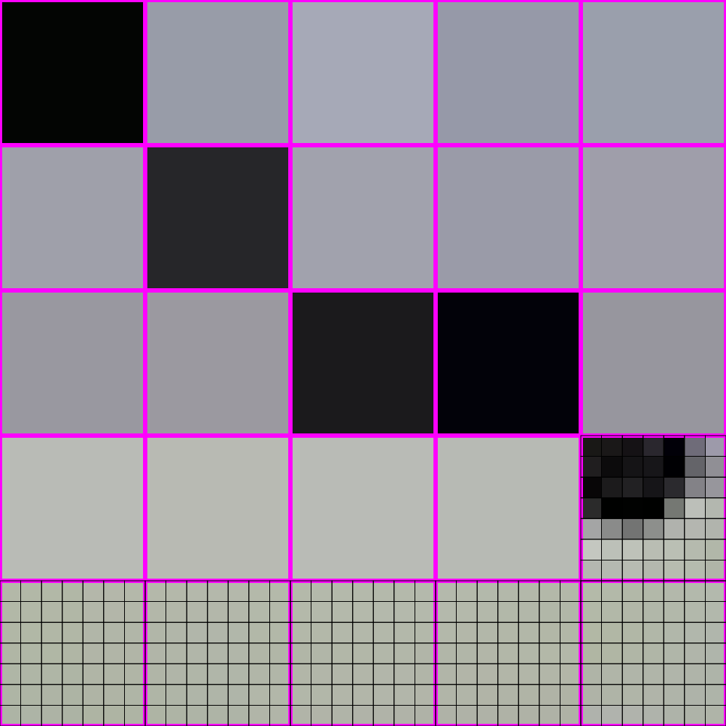
448x448 -> 64x64

Slide 63
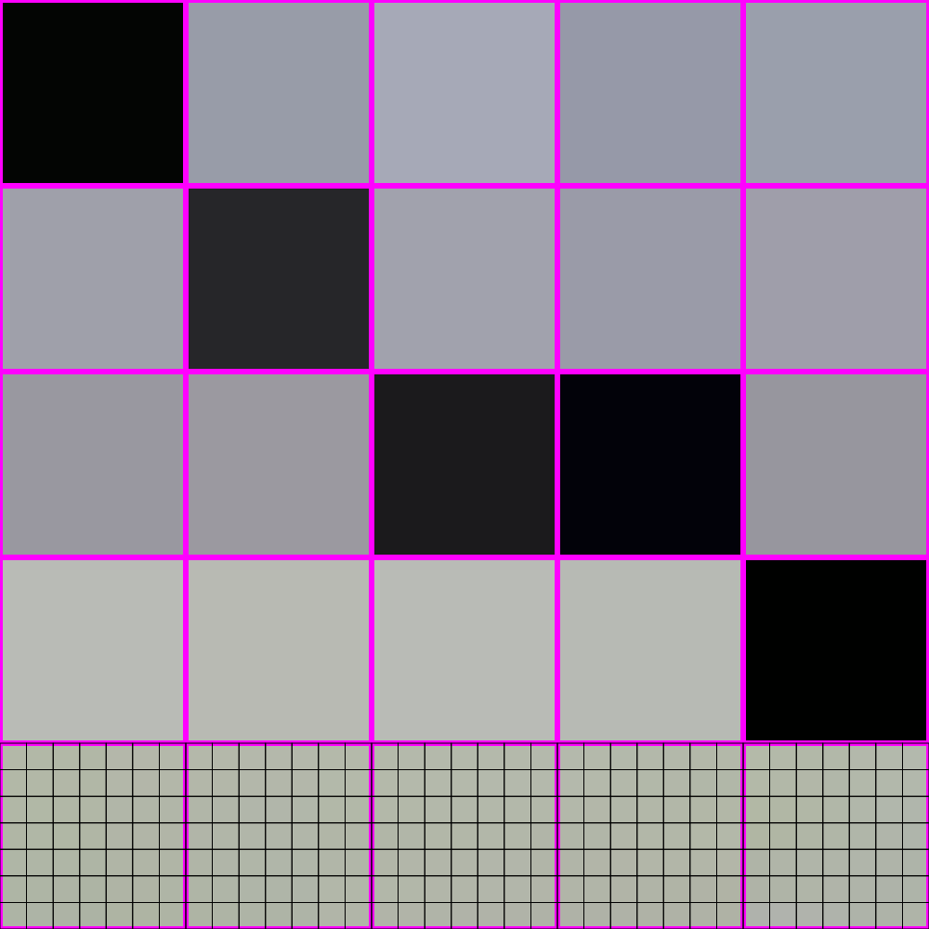
448x448 -> 64x64

Slide 64
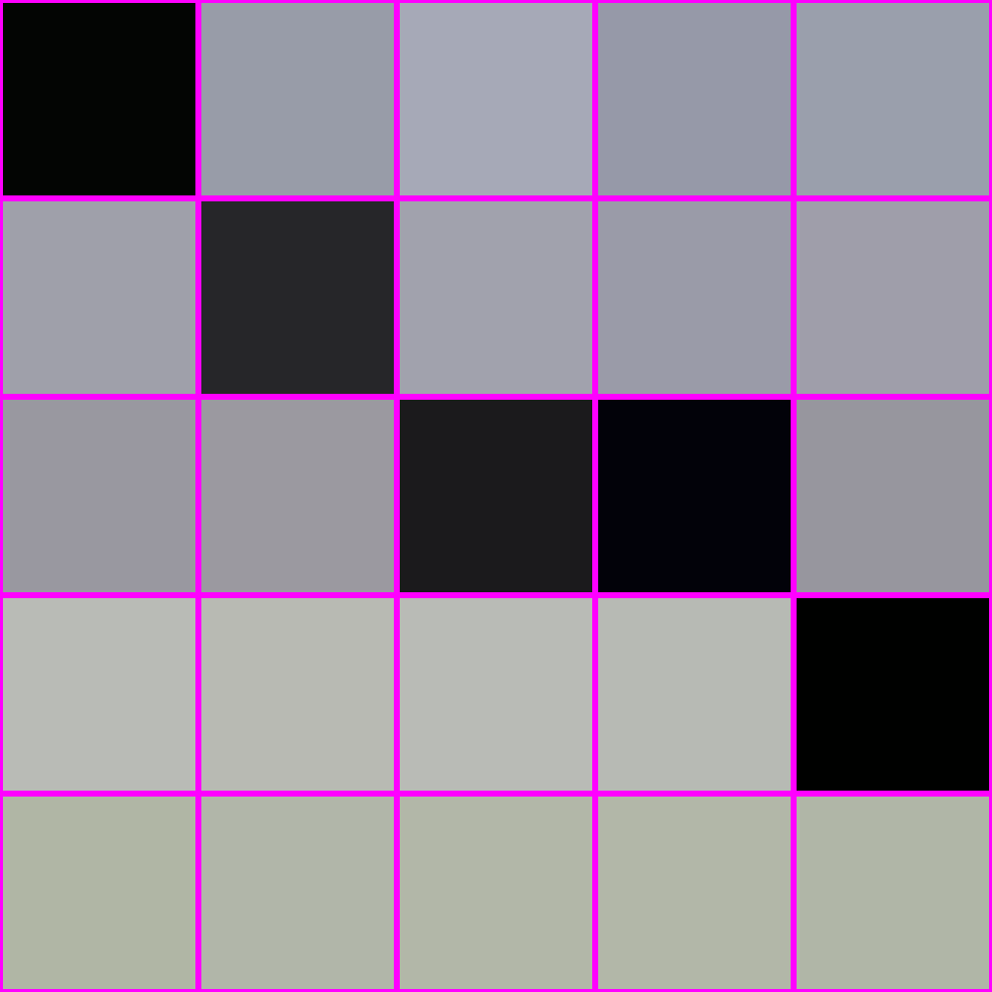
448x448 -> 64x64

Slide 65
448x448 -> 64x64

Slide 66
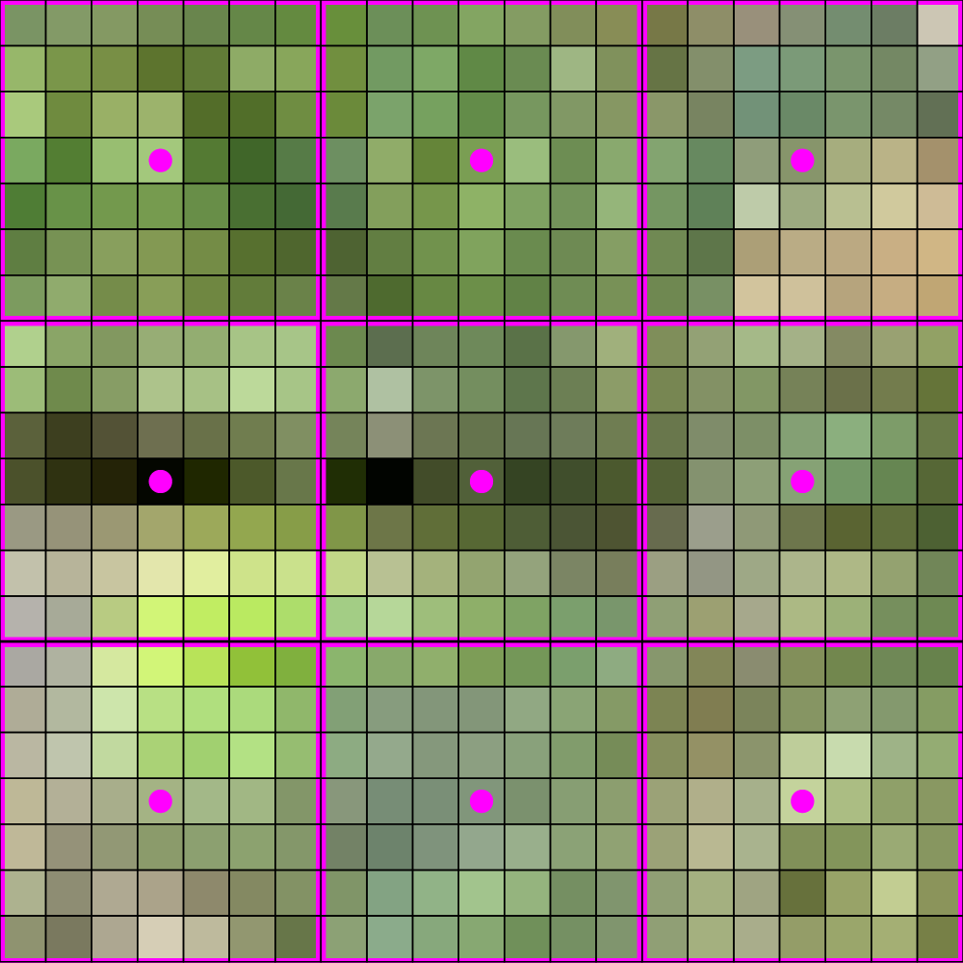
448x448 -> 64x64
Note: this example assumes that the
interpolation lands at the center of
each of the big 7 x 7 areas of pixels.

Slide 67
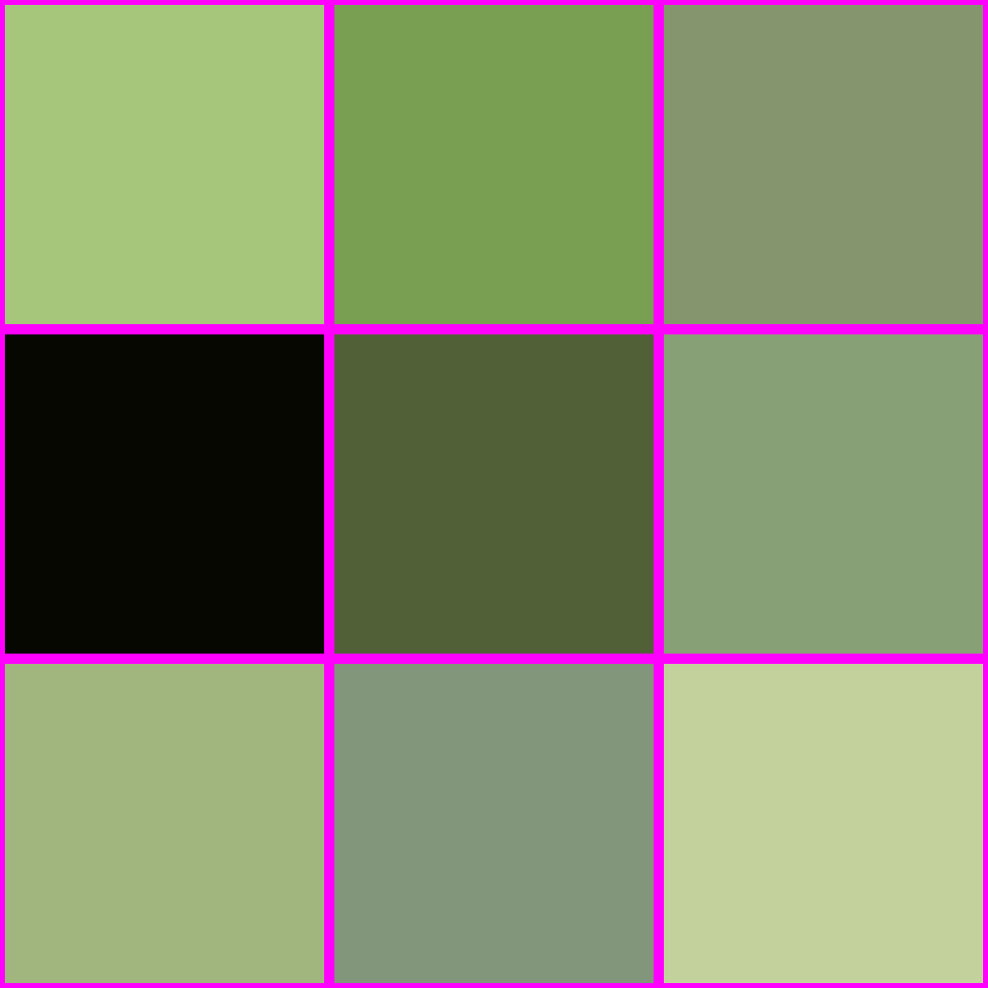
448x448 -> 64x64

Slide 68
IS THIS ALL THERE IS??

Slide 69

THERE IS A BETTER WAY!

Slide 70

LOOK AT HOW MUCH BETTER

Slide 71
How do?

Slide 72
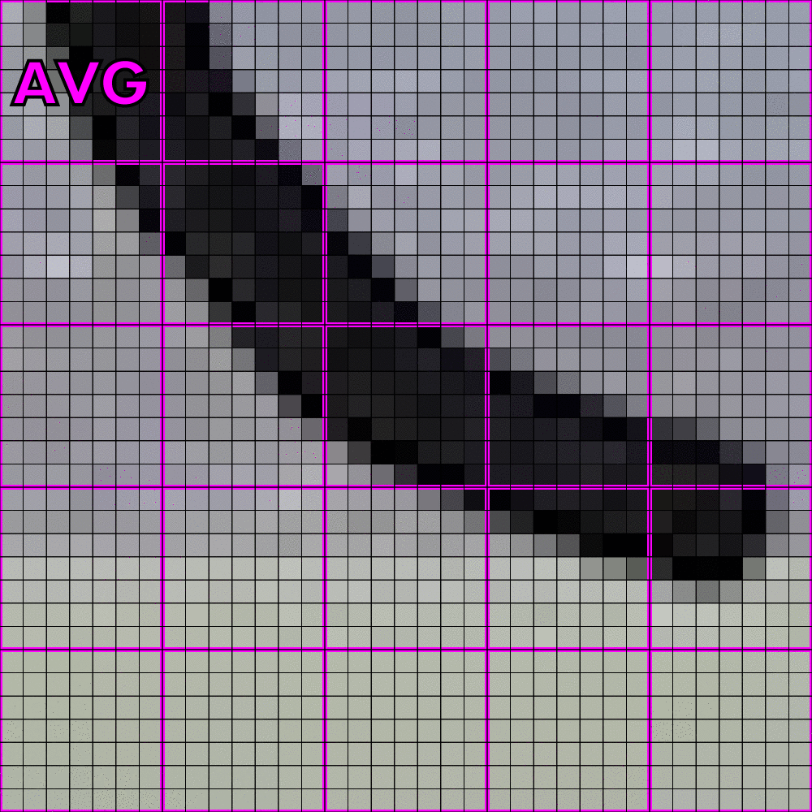
How do? Averaging!

Slide 73

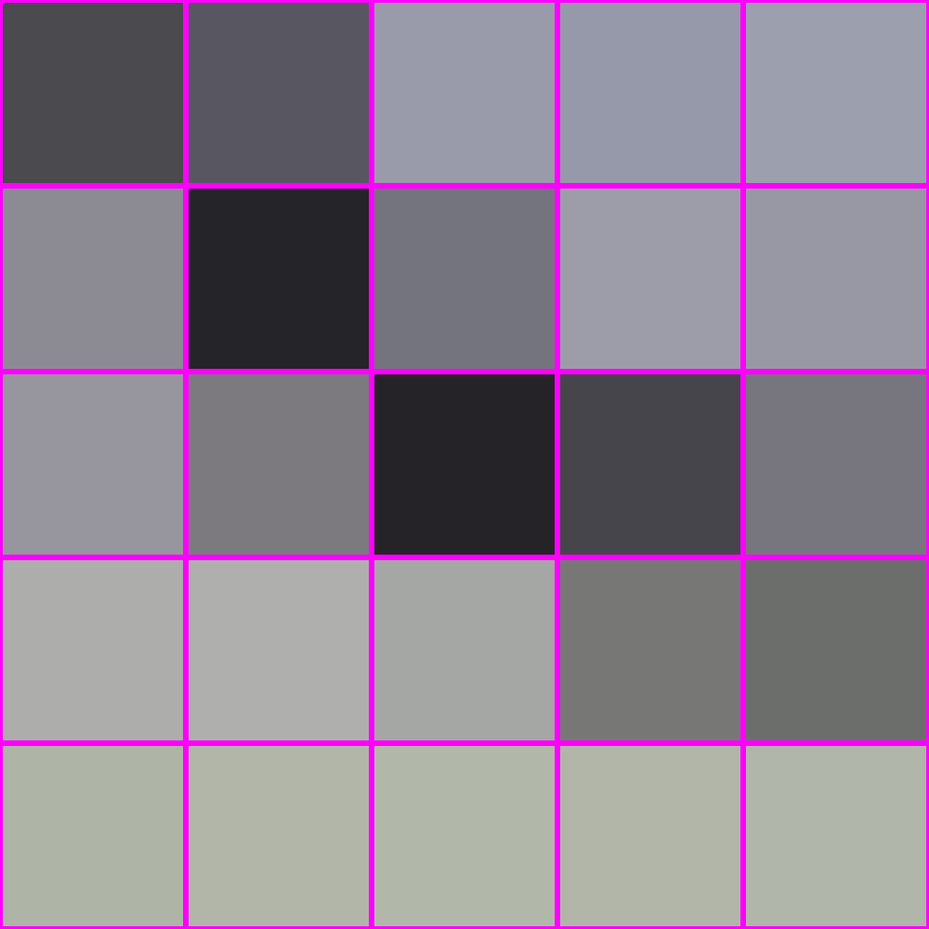
How do? Averaging!
“interpolation”
averaging
X

Slide 74

What is averaging?

Slide 75
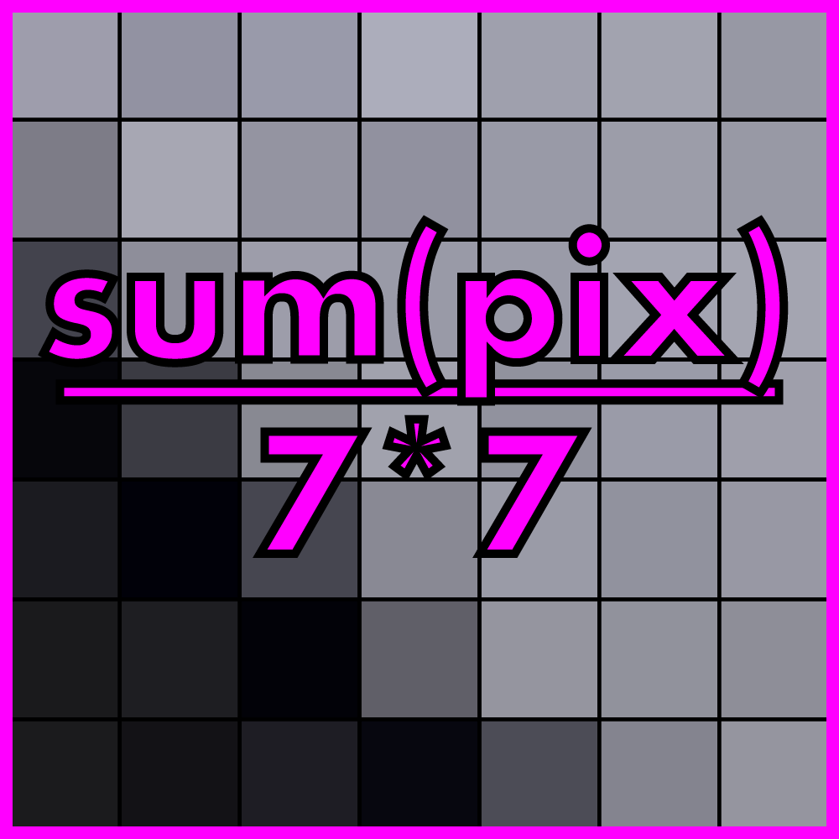
What is averaging? A weighted sum

Slide 76
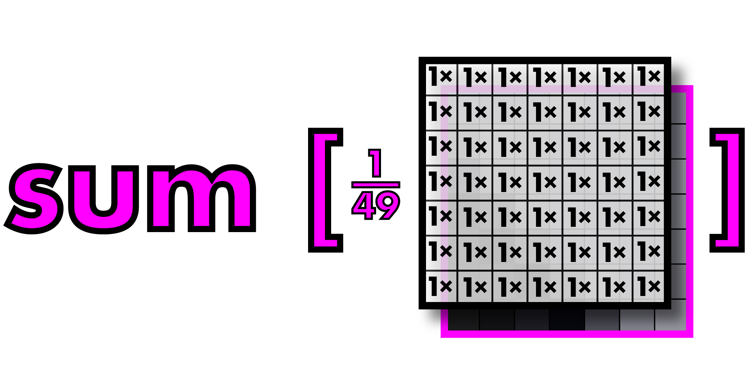
What is averaging? A weighted sum

Slide 77
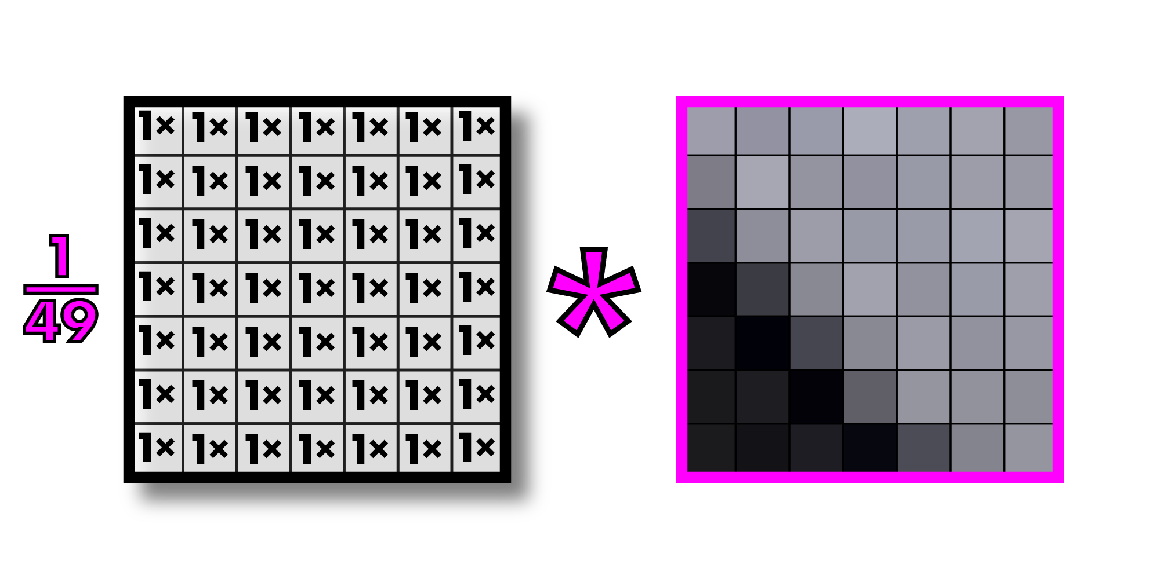
Call this operation “convolution”
Filter or kernel
Note: multiplying an image section by a filter is actually called “correlation” and convolution
involves inverting the filter first, but since our filters are generally symmetric, we call
everything convolution. This is what all computer vision people do.

Slide 78
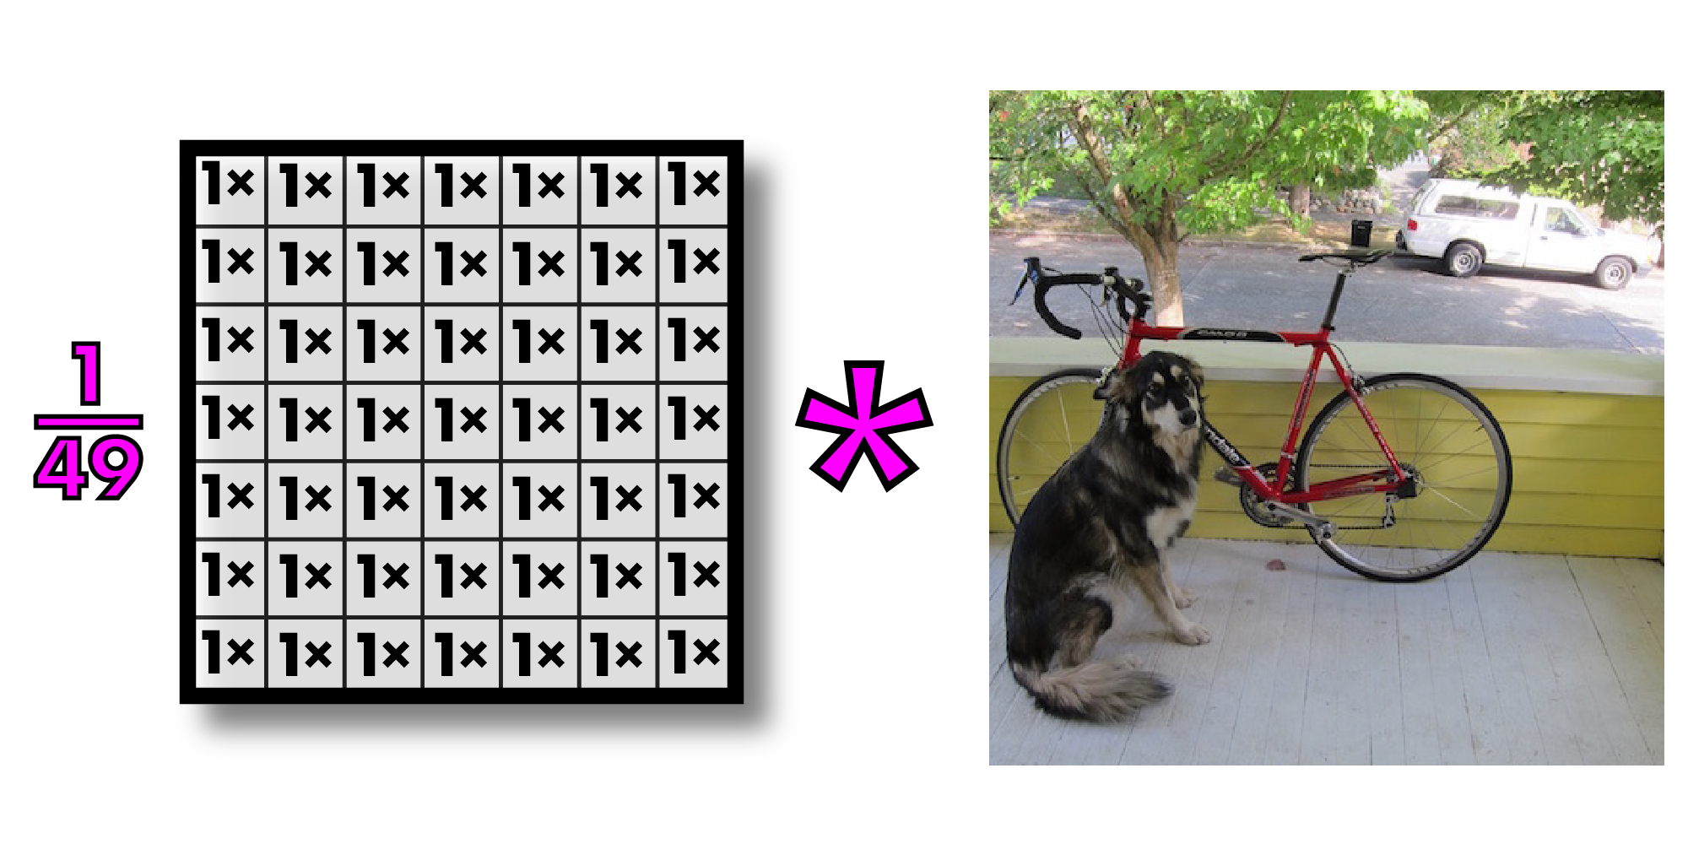
Convolutions on larger images

Slide 79
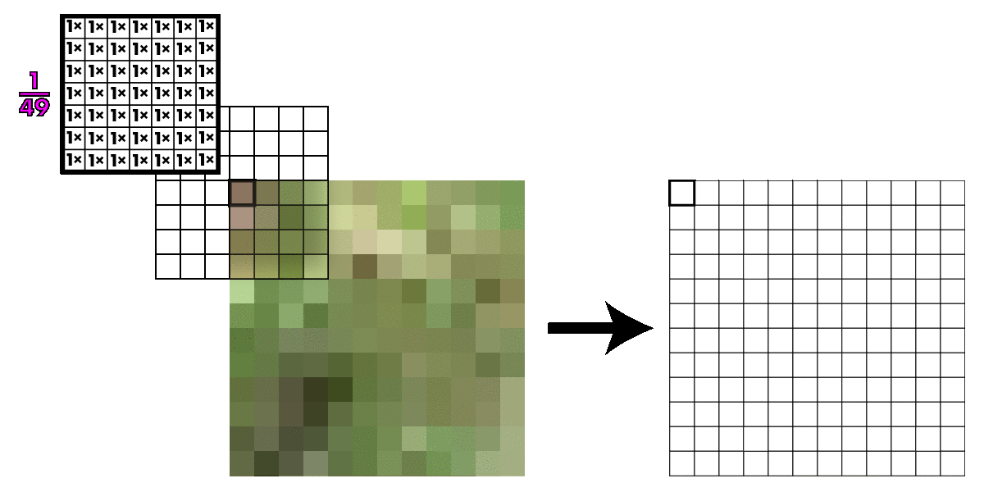
Kernel slides across image

Slide 80
Kernel slides across image
What happens at the edges of the images?
Zero padding: easiest but can give bad results
Duplicate the outermost row or column
Use wraparound

Slide 81
Assignment 2
Image resizing and filtering

Slide 82
Assignment 2- Programming Assignment
Implement Nearest Neighbor Interpolation and Resizing (input image- Resize using NNInterpolation and output new resized image)
Bilinear Interpolation and Resizing (input image- Resize using BiLInterpolation and output new resized image)
Implement Convolution (input Image – Convolved image)
Gaussian Filter ( input image- Apply Gausian filter-Output filtered image)

Slide 83
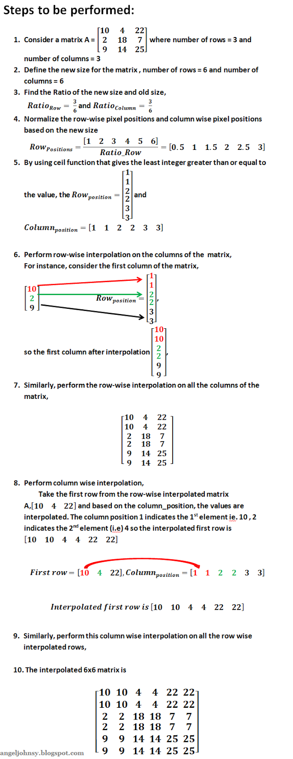
Nearest Neighbor Interpolation

